Slide 1


Digital Geography: Roles of Sovereignty, Culture & Community in the Digital Media & Communications Landscape
Foundations of Digital Media | Class 3
UBC
Fall 2017
Jon Festinger Q.C.
Centre for Digital Media
Allard Law of Law, UBC
QMUL School of Law (CCLS)
Festinger Law & Strategy
http://commlaw.allard.ubc
Twitter: @jonfestinger
jon_festinger@thecdm.ca

Slide 2
Logistics

Slide 3

Course Website
http://arts-foundations.sites.olt.ubc.ca/

Slide 4
For full privileges on the website
1. Please create an account at http://cms.ubc.ca/ using your CWL.
2. Once you create an account and sign in at http://cms.ubc.ca/ you can click your name in the top right. Half way down the following page will be your WordPress email address.
3. Send me your WordPress email address at jfestinger@telus.net or at jon@fblawstrategy.com
4. Then, I will invite you to participate with authoring privileges via your WordPress email address.

Slide 5
Presentation Groups?

Slide 6
Group Presentations
2 per group?
Sign-up at the break or email me
Any topic – not constrained by what I’m talking about that week
Consult with me re the topic you want to take on
Post one or two things you want us to read or watch

Slide 7
News of the Week

Slide 8
Yours?

Slide 9


Slide 10


Slide 11


Slide 12


Slide 13
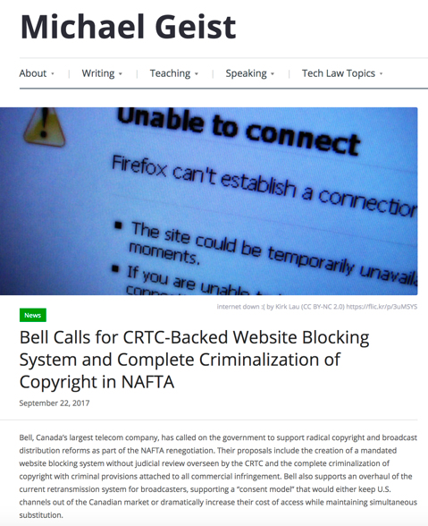

Slide 14


Slide 15
Digital Geography: Roles of Sovereignty, Culture & Community in the Digital Media & Communications Landscape

Slide 16

Start

Slide 17

Different rules for different screens (& boxes)

Slide 18
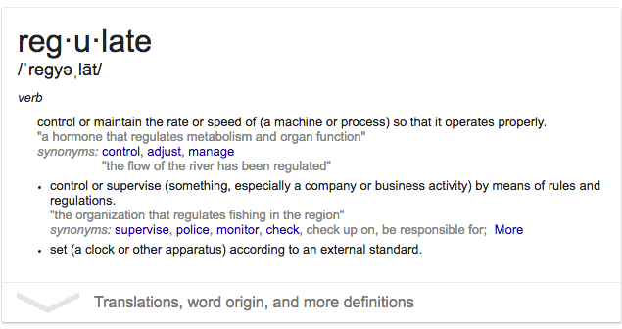
“Regulate” = make regular

Slide 19
D.L Shaw, “The Rise and Fall of American Mass
Media: Roles of Technology and Leadership”, April 1991 “Roy W. Howard Lecture” Indiana University.
“No medium, once it has lost it’s dominant position has ever returned to the top”
“Audience choice, made possible by modern technologies, has made the concept of “mass media” obsolete; and audiences are not necessarily loyal, exercising choices when available to obtain information and entertainment in the most efficient way possible.”
“Historically mass media seem to play the role of Trojan Horse to social change. That seems to be an effect of evolving communication technologies.”
Limitation – does not foresee audience as CREATOR

Slide 20


Slide 21
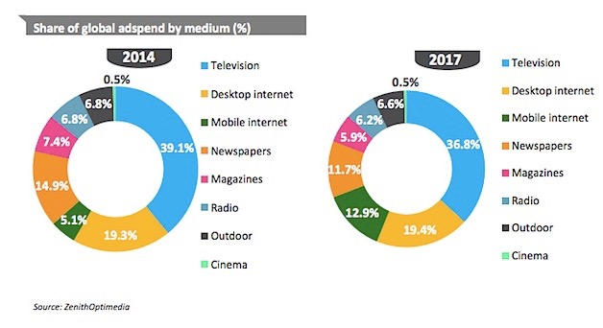

Slide 22
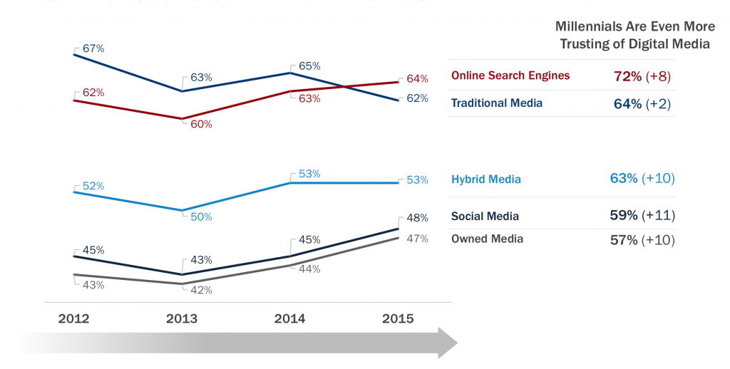

Slide 23

So what about?

Slide 24
Constraints Distort Creativity
10. Internet Governance & Surveillance (International Law)
9. Taxation/Currency/Gambling/Criminal/Obscenity
(Criminal & Quasi Criminal)
8. Misleading promises/advertising, physical or
psychological harm, unfair competition/anti-trust
(consumer protection)
7. Industry self regulation (delegated authority) & medium
specific regulation (constitutional)
Out of the Creation Norms (Censorship) ----------------------------------------------------------------------------------------------------------------
In the Creation Ethics (of Originality, Creativity & Expression)
6. EULA/ToS & Contracts (contractual, private)
5. Privacy, Defamation & Personality law (tort, IP)
4. Trademark, Patents & the IP Business
3. Copyright & Users Rights (statutory)
2. Technology (quasi extra-legal)
1. Community (extra-legal)

Slide 25
Core
Binaries

Slide 26

Cultural/Industrial
  a. Domestic Ownership
  b. CBC

Slide 27
Content/Carriage
→
Vertical Integration

Slide 28

Regulation/Free Market
    Cellular

Slide 29

Privacy/Surveillance
commercial/gov’t →

Slide 30

Where are we actually ?

Slide 31
Vertically integrated free market → oligopoly
Free market industrial surveillance through carriage.

Slide 32
Starting Point #2: For Today

Slide 33
Roles of Sovereignty & Culture in the Communications Landscape

Slide 34
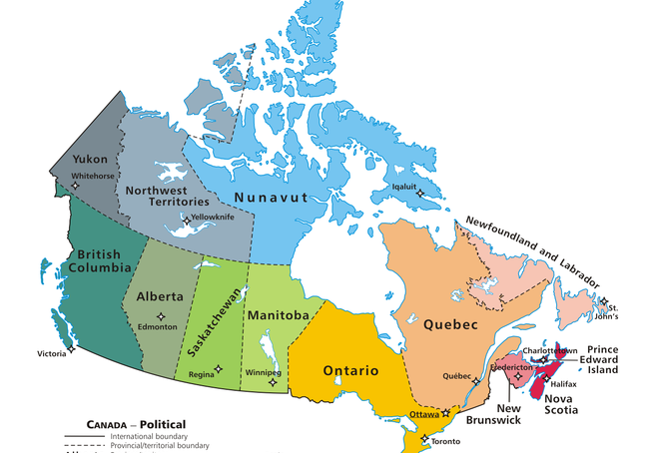

Slide 35
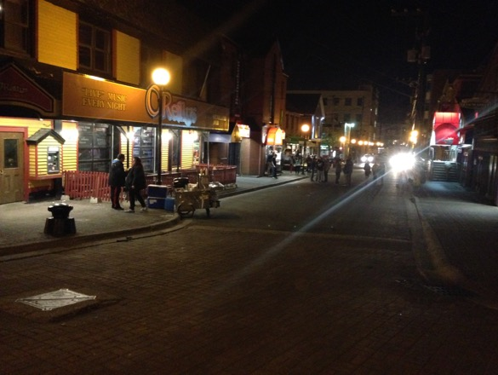
Does sovereignty makes sense? Does culture make sense?

Slide 36
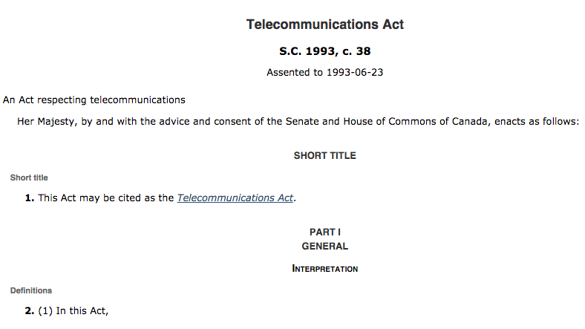

Slide 37
4. This Act does not apply in respect of broadcasting by a broadcasting undertaking.
36. Except where the Commission approves otherwise, a Canadian carrier shall not control the content or influence the meaning or purpose of telecommunications carried by it for the public.

Slide 38
Canadian Telecommunications Policy
Objectives
7 It is hereby affirmed that telecommunications performs an essential role in the maintenance of Canada’s identity and sovereignty and that the Canadian telecommunications policy has as its objectives
(a) to facilitate the orderly development throughout Canada of a telecommunications system that serves to safeguard, enrich and strengthen the social and economic fabric of Canada and its regions;

Slide 39
(b) to render reliable and affordable telecommunications services of high quality accessible to Canadians in both urban and rural areas in all regions of Canada;
(c) to enhance the efficiency and competitiveness, at the national and international levels, of Canadian telecommunications;
(d) to promote the ownership and control of Canadian carriers by Canadians;
(e) to promote the use of Canadian transmission facilities for telecommunications within Canada and between Canada and points outside Canada;

Slide 40
(f) to foster increased reliance on market forces for the provision of telecommunications services and to ensure that regulation, where required, is efficient and effective;
(g) to stimulate research and development in Canada in the field of telecommunications and to encourage innovation in the provision of telecommunications services;
(h) to respond to the economic and social requirements of users of telecommunications services; and
(i) to contribute to the protection of the privacy of persons.

Slide 41
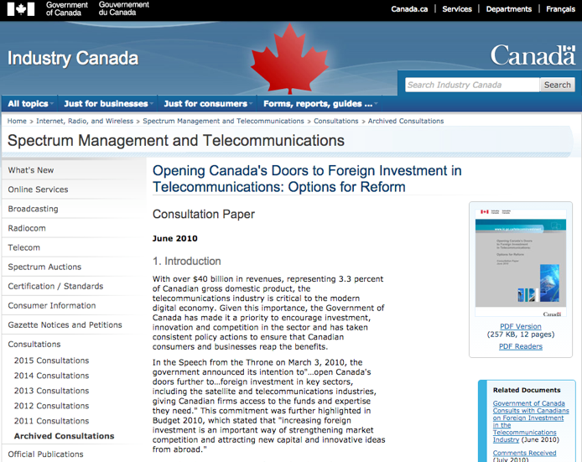
https://www.ic.gc.ca/eic/site/smt-gst.nsf/eng/sf09920.html

Slide 42
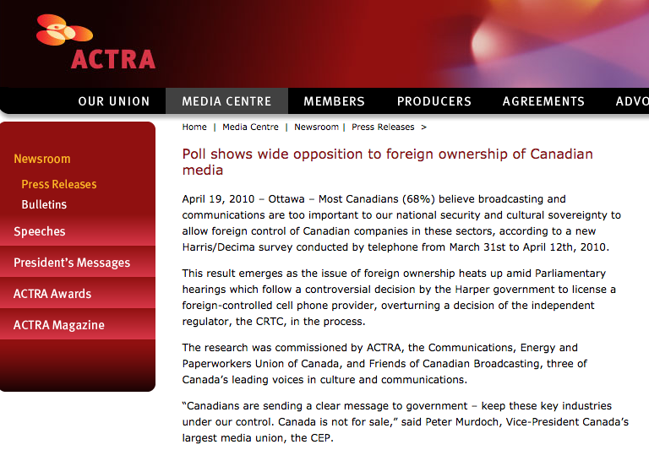

Slide 43

In Telecom the issue seems to be
SOVERIGNTY/(OWNERSHIP)

Slide 44
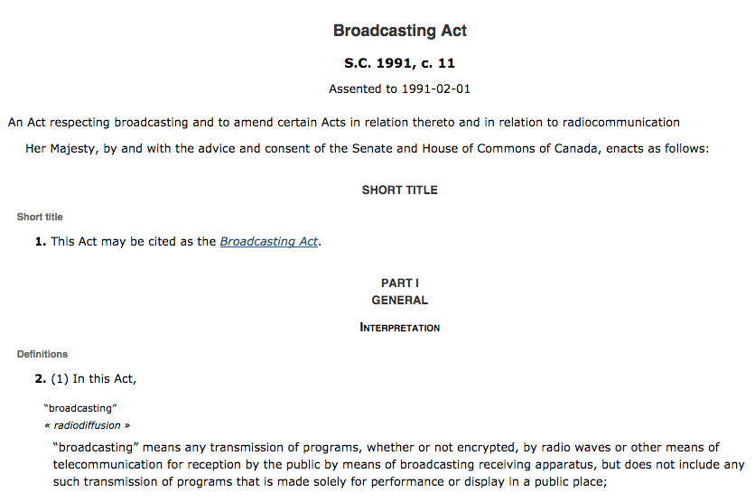

Slide 45
Huh?
Broadcasting Policy for Canada
3 (1) It is hereby declared as the broadcasting policy for Canada that
  (a) the Canadian broadcasting system shall be effectively owned and controlled by Canadians;
  (b) the Canadian broadcasting system, operating primarily in the English and French languages and comprising public, private and community elements, makes use of radio frequencies that are public property and provides, through its programming, a public service essential to the maintenance and enhancement of national identity and cultural sovereignty;

Slide 46
(c) English and French language broadcasting, while sharing common aspects, operate under different conditions and may have different requirements;
(d) the Canadian broadcasting system should
  (i) serve to safeguard, enrich and strengthen the cultural, political, social and economic fabric of Canada,
  (ii) encourage the development of Canadian expression by providing a wide range of programming that reflects Canadian attitudes, opinions, ideas, values and artistic creativity, by displaying Canadian talent in entertainment programming and by offering information and analysis concerning Canada and other countries from a Canadian point of view,
  (iii) through its programming and the employment opportunities arising out of its operations, serve the needs and interests, and reflect the circumstances and aspirations, of Canadian men, women and children, including equal rights, the linguistic duality and multicultural and multiracial nature of Canadian society and the special place of aboriginal peoples within that society, and
  (iv) be readily adaptable to scientific and technological change;

Slide 47
(e) each element of the Canadian broadcasting system shall contribute in an appropriate manner to the creation and presentation of Canadian programming;
(f) each broadcasting undertaking shall make maximum use, and in no case less than predominant use, of Canadian creative and other resources in the creation and presentation of programming, unless the nature of the service provided by the undertaking, such as specialized content or format or the use of languages other than French and English, renders that use impracticable, in which case the undertaking shall make the greatest practicable use of those resources;

Slide 48
The News?
(g) the programming originated by broadcasting undertakings should be of high standard;
(h) all persons who are licensed to carry on broadcasting undertakings have a responsibility for the programs they broadcast;

Slide 49
The CBC
(i) the programming provided by the Canadian broadcasting system should
  (i) be varied and comprehensive, providing a balance of information, enlightenment and entertainment for men, women and children of all ages, interests and tastes,
  (ii) be drawn from local, regional, national and international sources,
  (iii) include educational and community programs,
  (iv) provide a reasonable opportunity for the public to be exposed to the expression of differing views on matters of public concern, and
  (v) include a significant contribution from the Canadian independent production sector;

Slide 50
Tie-breakers???
(n) where any conflict arises between the objectives of the Corporation set out in paragraphs (l) and (m) and the interests of any other broadcasting undertaking of the Canadian broadcasting system, it shall be resolved in the public interest, and where the public interest would be equally served by resolving the conflict in favour of either, it shall be resolved in favour of the objectives set out in paragraphs (l) and (m);
(2) It is further declared that the Canadian broadcasting system constitutes a single system and that the objectives of the broadcasting policy set out in subsection (1) can best be achieved by providing for the regulation and supervision of the Canadian broadcasting system by a single independent public authority.

Slide 51

In Broadcasting the issue seems to be
CULTURE (OWNERSHIP)

Slide 52

Does this sound familiar?…
Prime Minister R.B. Bennett 1932: “…this country must be assured of complete Canadian control of broadcasting from Canadian sources. Without such control, broadcasting can never be the agency by which national consciousness may be fostered and sustained and national unity still further strengthened….”

Slide 53
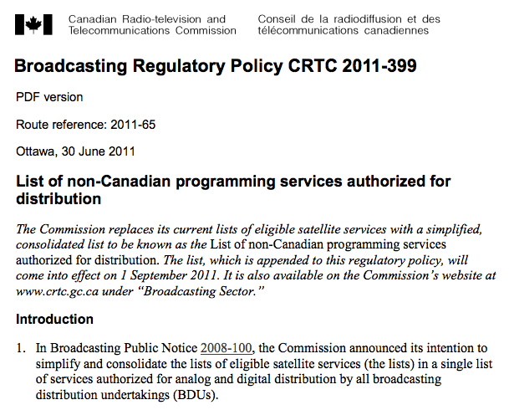

Slide 54
A strange digression…
One Act, or Two, or more?

Slide 55

Why the differences between technologies?

Slide 56
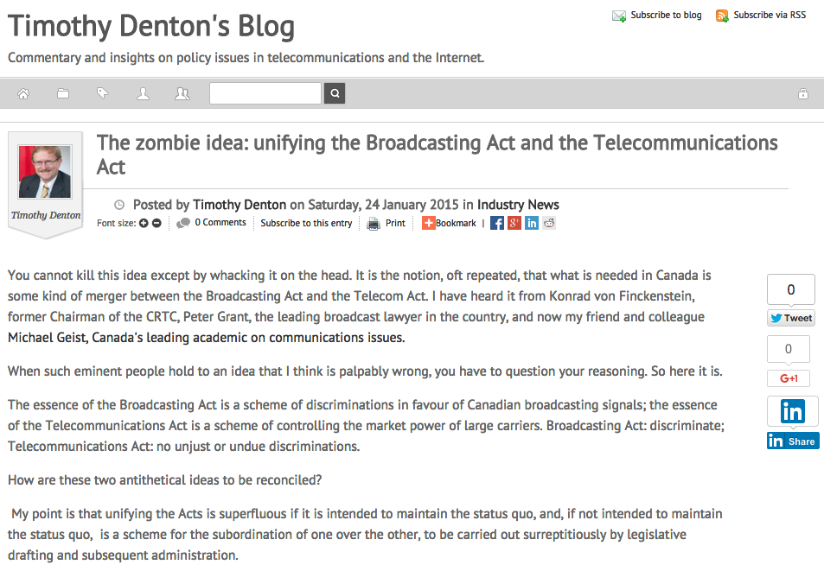
http://tmdenton.com/index.php/easyblog/entry/the-zombie-idea-unifying-the-broadcasting-act-and-the-telecommunications-act

Slide 57

Digital net doesn’t fit…culture or sovereignty all that well???

Slide 58
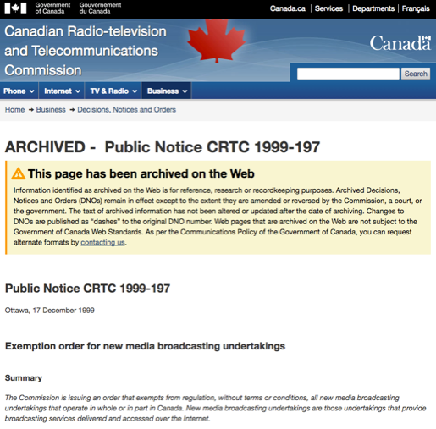
Does all this explain?…

Slide 59
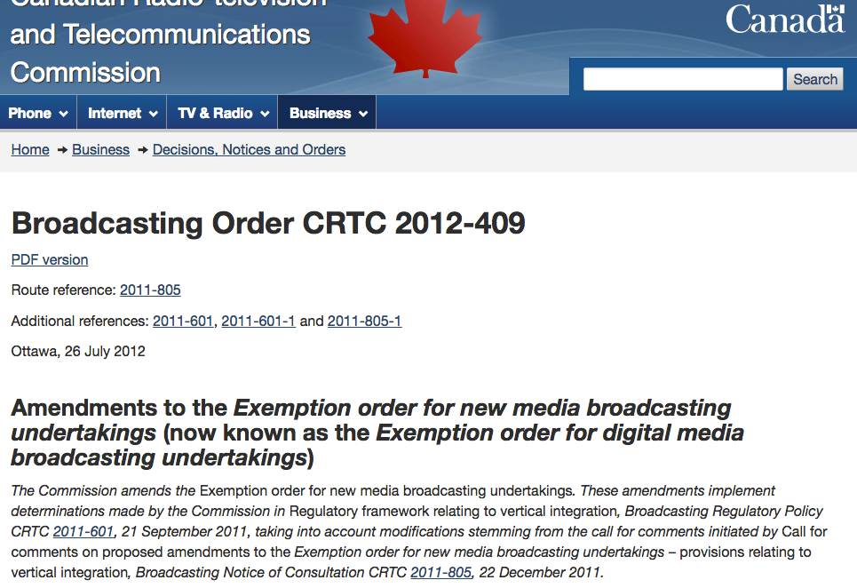

Slide 60
Who’s Who ????????
  The CRTC: telecom & broadcasting regulator
  Industry Canada: telecom policy maker & spectrum regulator
  Canadian Heritage: broadcasting & cultural policy maker
  Other agencies: Courts, Competition Bureau; CCTS, various self-regulatory bodies

Slide 61
Starting Point #3: Broadcasting History
Many of the slides in this section are only slightly adapted
from those prepared by Hank Intven of McCarthy’s.

Slide 62
Early Radio
1913 Radiotelegraph Act
Federal government Minister authorized licensed radio broadcasters. There was small license fee for each radio receiver [remnant in Radiocommunication Act - p. 65 “Black Book” - 4 (1) No person shall, except under and in accordance with a radio authorization, install, operate or possess radio apparatus, other than: (a) radio apparatus exempted by or under regulations made under paragraph 6(1)(m); or (b) radio apparatus that is capable only of the reception of broadcasting and that is not a distribution undertaking.]
1928 - 68 radio stations; 400,000 battery-operated radios
Mostly private stations
CNR radio department formed 1st national broadcasting network

Slide 63
1928-9: Aird Royal Commission
First major policy review of Canadian broadcasting. Key issues:
1. Lack of Canadian programming: “the majority of programs heard are from sources outside of Canada…[this] has a tendency to mold the minds of young people in the home to ideas and opinions that are not Canadian”
2. Universal service issues: Uneven availability of Canadian services and programming in different parts of the country.

Slide 64
Aird: Key Recommendations
The federal government should create a national broadcaster to promote Canadian unity and development – and to inform the public on questions of Canadian national interest
“…broadcasting will undoubtedly become a great force in fostering a national spirit and interpreting national citizenship…”

Slide 65
1932 Radio Reference intervenes
During the Aird Commission’s work, Québec passed legislation authorizing provincial licensing and regulation of radio broadcasting.
In Re Regulation and Control of Radio Communication, [1932] A.C. 304 Privy Council ruled jurisdiction over broadcasting was federal only.
Case did not address the “content question” directly. Question referred to the court was: “Has the Parliament of Canada jurisdiction to regulate and control radio communication, including the transmission and reception of signs, signals, pictures and sounds of all kinds by means of Hertzian waves, and including the right to determine the character, use, and location of the apparatus employed?”

Slide 66
Found the basis of federal jurisdiction in S. 92(10)(a) BNA Act: “Lines of Steam or other Ships, Railways, Roads, Telegraphs, and other Works and Undertakings connecting the Province with any other or others of the Provinces, or extending beyond the Limits of the Province.”
Viscount Dunedin: “Broadcasting as a system cannot exist without both a transmitter and a receiver. The receiver is indeed useless without a transmitter and can be reduced to a nonentity if the transmitter closes. The system cannot be divided into two parts, each independent of the other. "Undertaking" is not a physical thing but is an arrangement under which of course physical things are used.”

Slide 67
Canadian Radio Broadcasting Commission
After the Radio Reference, the Conservative R.B. Bennett government established the CRBC to:
Regulate, control and carry on broadcasting activities in Canada, in the national interest.
Take over operations of the CNR national radio network.
Regulate private broadcasters, and over time, assume control over all aspects of Canadian broadcasting.
The latter objective was frustrated by the great depression of the 1930s, which prevented the government from buying out private radio operators and entrenching Canada’s mixed public private system (unlike UK and European systems of the time).
CRBC’s joint operator/regulator role transferred to CBC in 1936 – funded by increased licence fees

Slide 68
Fowler Commission & Committee
(1957 & 1965)
Canadian television started in Montréal & Toronto in 1952
  Initially 1 private station licensed per market to carry the CBC’s national programming
  Public demand for more choice and content
Fowler recommended separation of public broadcaster/regulator roles
  inherent conflict of interest for CBC
  1958 Broadcasting Act created the Board of Broadcast Governors (BBG) as regulator

Slide 69
1968 Broadcasting Act
1. New Act followed
1964 Fowler Committee Report
1966 White Paper on Broadcasting
2. Distanced government and the regulator from administration, finance and broadcast programming decisions of CBC
3. Established & mandated CRTC to implement a new “broadcasting policy” for Canada:
to safeguard, enrich and strengthen Canadian sovereignty
to ensure Canadian ownership and control of system
to promote high quality programming with substantial Canadian content
to limit concentration of private station ownership
to bring cable TV under CRTC jurisdiction

Slide 70
CRTC Initiatives to Implement 1968 Act
1. Pierre Juneau appointed first chair
2. Order in Council 1968-1809 required all broadcasting undertakings (including cable TV) to be 80% Canadian-owned
3. Established and enforced Canadian programming content quotas for CBC and private broadcasters
Radio (leading to naming of “Juno” awards)
TV (leading to everlasting frustration of Canadian viewers)

Slide 71
1991 Broadcasting Act
Current legislation – still in force
Four parts
I –Definitions & New Broadcasting Policy
II –Objects & Powers of CRTC re Broadcasting
III –Powers & Functions of CBC
IV –Related & Consequential Amendments

Slide 72
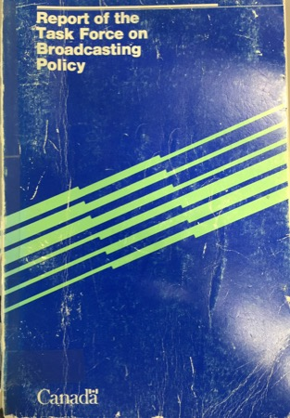
Q: Did we lose our opportunity?
Caplan/Sauvageau Report, 1986

Slide 73
A: Precisely here?...
“But whatever kind of Buck Rogers Future is in store for us, surely the Canadian tradition demands that we must continue to entrench the Canadian presence in our broadcasting system, and we must adopt policies to do so in a new world in which substantially greater choice may be available to Canadian viewers. More than ever, broadcasting must be seen as a fundamental part of cultural policy. It must be program-driven, not hardware-driven as in its first decades.”

Slide 74
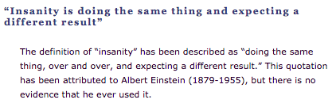
Entrench because tradition demands it
Broadcasting must be seen as cultural policy

Slide 75
Starting Point #4: Telecom History
Many of the slides in this section are only slightly adapted
from those prepared by Hank Intven of McCarthy’s.

Slide 76
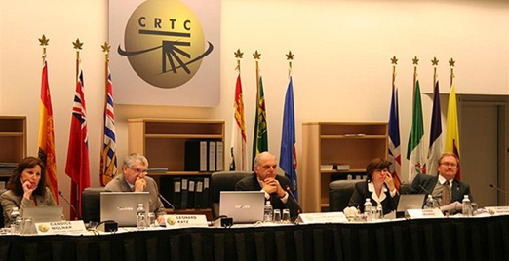
It’s own world ?
E.G. Telecom (not broadcasting) CRTC hearings under oath, with cross-examination (run by counsel)

Slide 77
The Canadian Telecom Industry
Telecom Service Providers (TSPs)
LECs - ILECs & CLECs
Resellers – Wireline & MVNOs
(Voice over Internet Protocol (VOIP) providers)
Wireless Service Providers (WSPs)
Internet Service Providers (ISPs)
New Media (OTT) (?)

Slide 78
Telecom History
1852 First Telegraphs Act → construction powers & duty to dispatch messages in order received (1st telecom non-discrimination law)
1892 Federal Cabinet first regulates Bell Canada’s rates
1900’s (early) Federal Gov’t regulates spectrum

Slide 79
1905 Mullock Select Ctee. where Bell Telephone Co. of Canada was accused of neglecting unprofitable lines.
1906 Board of Railway Commissioners regulate telephone rate.
1908 Three prairie Bell franchises are nationalized (all but Sasktel re-privatized in the 1980’s)
1938 Board of Transport Commissioners as regulator

Slide 80
1950-56 Hush-A-Phone battle in U.S. courts. Hush-A-Phone v. United States, 238 F.2d 266 (D.C. Cir. 1956) held that a small, cup-like device which mounted on the speaking party's microphone, reducing the risk of conversations being overheard and increasing sound fidelity for the listening party could be attached to a phone despite the FCC’s finding in favour of ATT to the contrary.

Slide 81
1967 Canadian Transport Commission as regulator
1976 CRT(T)C as regulator & convergence of broadcasting & telecom regulation
1979 Private voice and data competition allowed in Canada. CRTC required telcos to interconnect with CNCP so CNCP could compete in that market.

Slide 82
1980 Terminal Attachment allowed in Canada by CRTC in CRTC 1980-82. Network harm “concerns” dealt with through Industry Canada equipment certification.
1982 Longstanding anti-trust concerns in the U.S. resulted in a consent decree breaking up of AT&T into regional RBOC’s. Monopoly regulation shifted to promotion of competition as the means to protect consumers.
1984 Wireless comes to Canada, Cantel/Rogers licensed by CRTC.

Slide 83
1985 CNCP denied entry into facilities-based long distance market due to concerns about the impact of competition on residential rates
1987 Long Distance Resale in Canada (resellers typically owned switches, but not long distance transmission lines.
1992 Long Distance Facilities Based competition allowed in Canada. Unitel (successor to CNCP) allowed to interconnect. Price wars follow. Long distance competition was never really successful. Today rates are low because the competitive pressures from new technologies.

Slide 84
1993 CRTC forbore from wireless regulation.
1994 Rate Base/Rate of Return Regulation replaced by a Price Cap Regime → Inflation-related formula sets upper limits of rates → Principles established to allow competitors to access incumbents “essential facilities” at cost-based rates.

Slide 85
1997 Local Competition (voice & data including internet) in Canada. Called for extensive unbundling of “essential facilities”. Followed by rapidly growing competition from cableco’s as they already had a 2nd wire to the home.
2006 Cabinet issues Telecom Policy Direction
“rely on market forces to maximum extent feasible”
CRTC measures to be efficient & proportionate
Generally streamline regulatory process services

Slide 86
2008 Traffic Throttling complaint
2009 CRTC Internet Traffic Management Practices (ITMP’s) Policy
Prior approval of discriminatory wholesale ITMP’s
Primary ISP’s must show valid reasons for discriminatory ITMP’s & limit harm
Preference for economic over technical ITMP’s
Disclosure to retail consumers

Slide 87
2014 CRTC Wireless Code
2016 Telecom Regulatory Policy CRTC 2016-496, Modern telecommunications services – The path forward for Canada’s digital economy → Broadband internet access as a basic telecommunications service

Slide 88
Why were/are Telecommunications
Services Regulated?
“Natural monopoly” given economies of scale for network infrastructure ?
Shift from monopoly towards competition (1984 forward)
Myths and memes of the information economy → “The Information Highway”
Security & Sovereignty

Slide 89
Telecom Act
7. Telecom policy objectives
24. Services to be offered under CRTC-approved tariffs
34. CRTC forbearance power (to be used, e.g. where competition is sufficient to protect consumers)
36. Carriers not to control content or influence meaning of telecoms carried for public
40. Interconnection orders

Slide 90
Telecommunications Act S. 27
Just and reasonable rates
27 (1) Every rate charged by a Canadian carrier for a telecommunications service shall be just and reasonable.
Unjust discrimination
(2) No Canadian carrier shall, in relation to the provision of a telecommunications service or the charging of a rate for it, unjustly discriminate or give an undue or unreasonable preference toward any person, including itself, or subject any person to an undue or unreasonable disadvantage.

Slide 91
Policy parameters of telecom regulation
Canadian Ownership
Universal Service
Cross-subsidies were possible (urban/rural; business/residential; long distance/local)
Competition (since 1984 through both competition & privatization e.g. AGT & MTS)

Slide 92
QUESTIONS? DISCUSSION?

Slide 93
Starting Point #5: Case Studies

Slide 94

Case Study #1

Slide 95
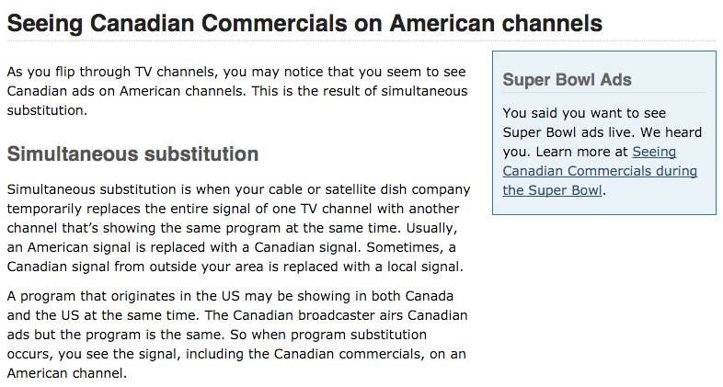
Simultaneous substitution

Slide 96
4 (1) …a licensee that receives a request referred to in section 3 must carry out the requested deletion and substitution if the following conditions are met:
  (a) the request is in writing and is received by the licensee at least four days before the day on which the programming service to be substituted is to be broadcast;
  (b) the programming service to be deleted and the programming service to be substituted are comparable and are to be broadcast simultaneously;
  (c) the programming service to be substituted has the same format as, or a higher format…

Slide 97

Which brings us to…
Capital Cities Communications Inc. v. CRTC. [1978] 2 S.C.R. 141

Slide 98

Held…
Cable television is part of a “single system” coming under Federal jurisdiction

Slide 99
Laskin, C.J.
“Rogers' licence, which is formally a licence to carry on a "broadcasting receiving undertaking", as defined in the Broadcasting Act, 1967-68 (Can.),…authorized it to serve certain areas of Metropolitan Toronto with an off-air broadcasting receiving antenna at a specified location. The licence specified eleven television broadcasting stations whose signals or programmes could be received by Rogers and distributed or retransmitted by it on the same or different channels,… Among the eleven television broadcasting stations included in the licence were three Buffalo stations, operated respectively by the three appellant com­panies and whose signals or programmes were carried over channels 2, 4 and 7.”

Slide 100

“The appellants were not and were not required to be licensed by the respondent CRTC. Their programmes reached Canadian viewers in areas adjacent to Buffalo, including Toronto, and were freely available to those whose television sets could directly receive those programmes. They could however receive them, and other programmes too which their sets could not attract, by becoming subscribers of Rogers through the latter's cable operation. I will consider the nature of that operation later on in these reasons. What precipitated the matters now before this Court was Rogers' decision, made and carried out some time prior to October, 1973, to delete commercial messages from the programmes received from the appellants' stations and to transmit those programmes to its subscribers without those messages but with substituted announcements of its own.”

Slide 101
“The fallacy in the contention on behalf of the Attorney-General of' Ontario and of the Attorneys-General of Quebec and of British Columbia, and, indeed, of the appellants, is in their reliance on the technology of transmission as a ground for shifting constitutional competence when the entire undertaking relates to and is dependent on extra-provincial signals which the cable system receives and sends on to subscribers. It does not advance their contentions to urge that a cable distribution system is not engaged in broadcasting. The system depends upon a telecast for its operation, and is no more than a conduit for signals from the telecast, interposing itself through a different technology to bring the telecast to paying subscribers.”

Slide 102
“I am therefore in no doubt that federal legislative authority extends to the regulation of the reception of television signals emanating from a source outside of Canada and to the regulation of the transmission of such signals within Canada. Those signals carry the programmes which are ultimately viewed on home television sets; and it would be incongruous, indeed, to admit federal legislative jurisdiction to the extent conceded but to deny the continuation of regulatory authority because the signals are intercepted and sent on to ultimate viewers through a different technology. Programme content regulation is inseparable from regulating the undertaking through which programmes are received and sent on as part of the total enterprise.”

Slide 103
Dystopia?!

Slide 104
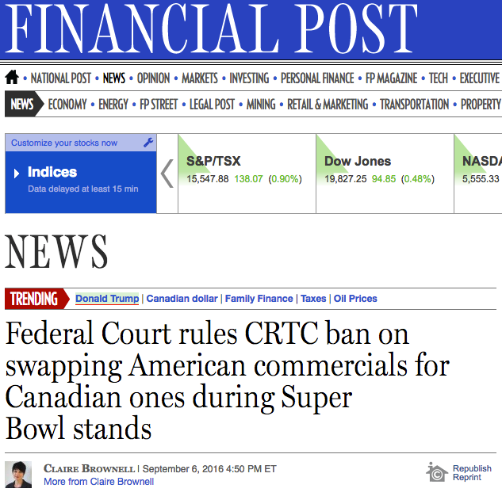

Slide 105


Slide 106
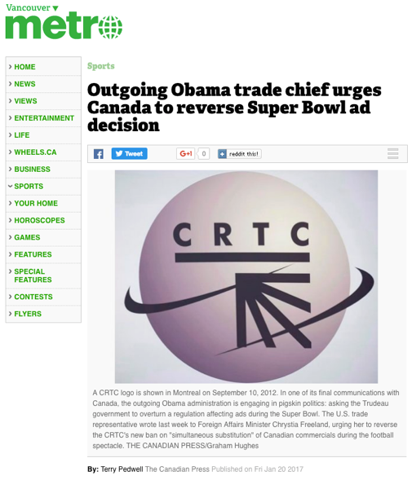

Slide 107


Slide 108


Slide 109


Slide 110
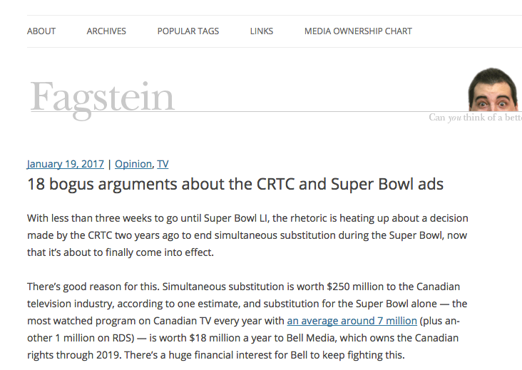

Slide 111
“1. Only 100 Canadians are against simultaneous substitution during the Super Bowl
2. The CRTC has ordered CTV to broadcast U.S. ads
3. Canadians have a right to see U.S. ads without censorship
4. This decision violates copyright law
5. Canadians shouldn’t have access to U.S. ads because they’re irrelevant and don’t have to comply with our laws

Slide 112
6. This decision is unnecessary because Canadians can watch the U.S. ads on YouTube (some even before the game)
7. The government should not be allowed to interfere in a private contract
8. If only CTV offered added value this wouldn’t be an issue
9. The CRTC made this decision without warning
10. This is a power trip by CRTC chairman Jean-Pierre Blais

Slide 113
11. Broadcasters are hypocrites for calling for more CRTC intervention while complaining about regulations
12. The CRTC made this decision because it doesn’t like boring Canadian Super Bowl ads
13. Simultaneous substitution is bad for Canada’s broadcasting system
14. If only Canada’s broadcast laws were more like American laws we wouldn’t be stuck in this mess

Slide 114
15. Everything worked fine with simultaneous substitution and the CRTC is ruining it
16. The CRTC should wait until after the federal government’s review of Canadian content before making these kinds of changes
17. We pay to subscribe to U.S. networks, so we should get them unfiltered
18. This is a slippery slope that will lead to the end of simultaneous substitution”

Slide 115


Slide 116
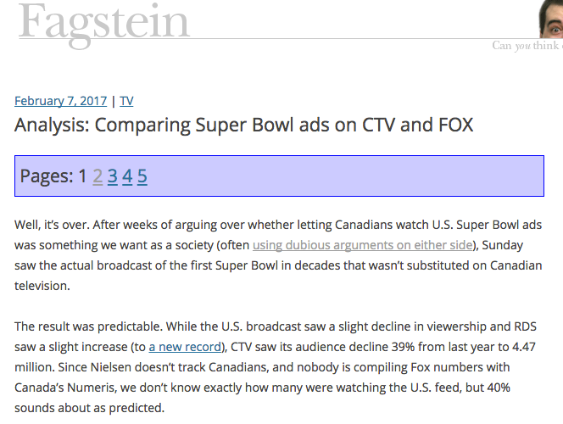
http://blog.fagstein.com/2017/02/07/super-bowl-ads-ctv-vs-fox/

Slide 117
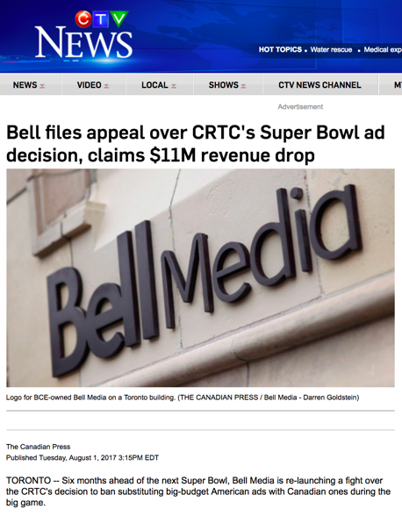

Slide 118
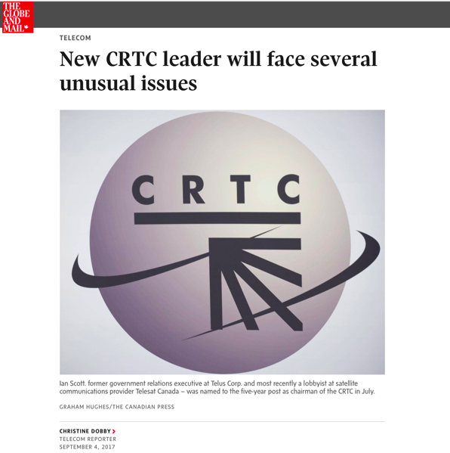

Slide 119
THOUGHTS? DISCUSSION?

Slide 120

Case Study #2

Slide 121
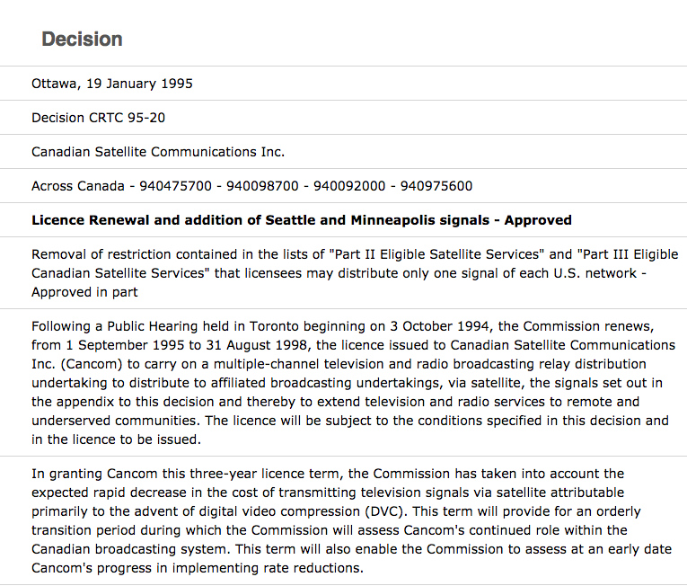

Slide 122

Case Study #3

Slide 123
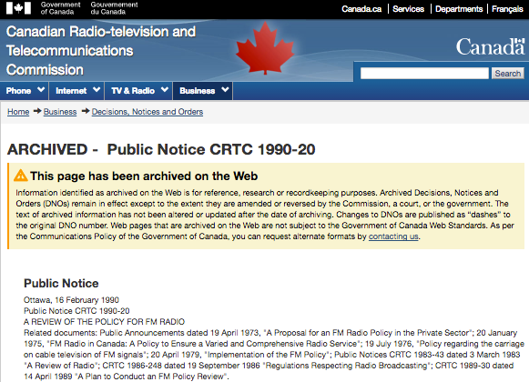
CRTC FM Regulations in the 1980’s

Slide 124

P.D.’s as accountants

Slide 125
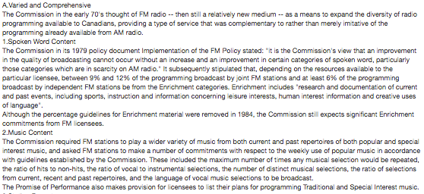
A. Varied and Comprehensive FM

Slide 126
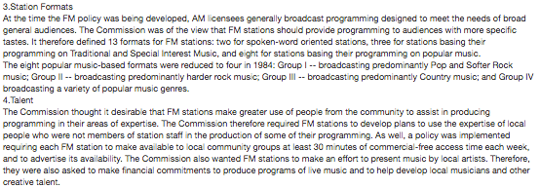

Slide 127
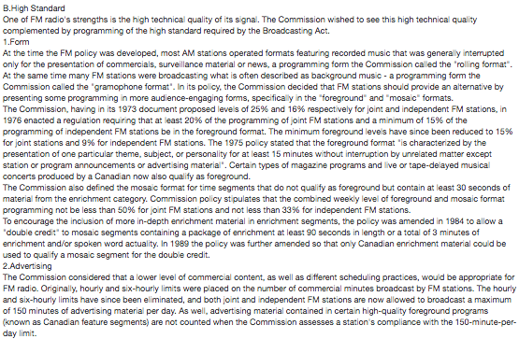
B. High Standard FM

Slide 128
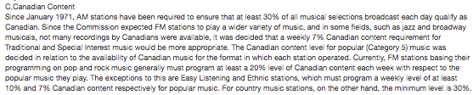
C. Canadian Content on FM

Slide 129
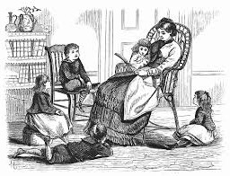
Story time…

Slide 130


Slide 131
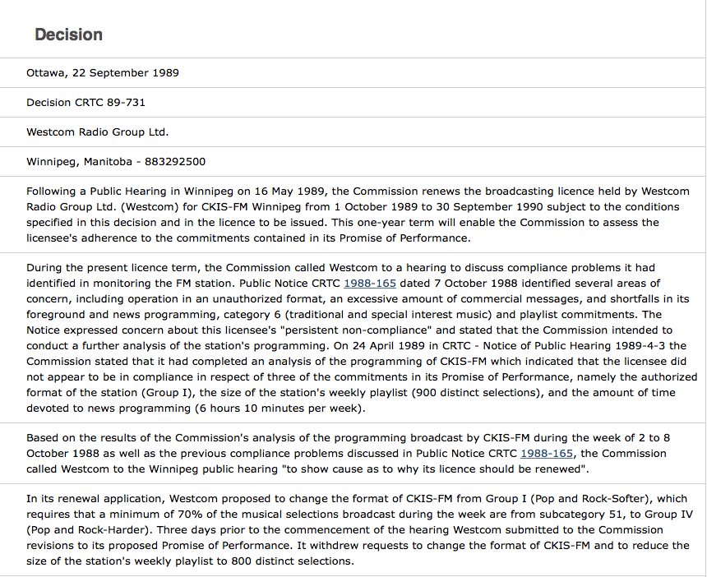

Slide 132
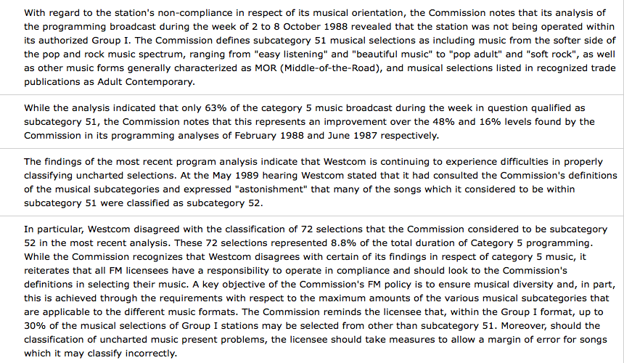

Slide 133

https://youtu.be/9Q7Vr3yQYWQ
@ 6:09 →

Slide 134
Re C.F.R.B. [1973] 3 O.R. 819 (Ont. CA)
Issue was Broadcasting Act prohibition of partisan comment on the day of and the day before a provincial election:
Kelly, J.A.: “Even if it be assumed that the decision in the Radio Reference case was intended to declare only the carrier system to be exclusively a subject for the legislative jurisdiction of Parliament, then the decision in that case at best is silent as to the right of Parliament to control and regulate the intellectual content of the material disseminated by the operation of the carrier system. Since there is no binding precedent holding that the control and regulation of the intellectual content is beyond the competence of Parliament, it would be flying in the face of all practical considerations and logic to charge Parliament with the responsibility for the regulation and control of the carrier system and to deny it the right to exercise legislative control over what is the only reason for the existence of the carrier system, i.e., the transmission and reception of intellectual material…”

Slide 135
Therefor…
“I am of the opinion that the exclusive legislative authority of Parliament with respect to radio communication extends to the control and regulation of the intellectual content of radio communication. If the Broadcasting Act comes within the classes of subjects assigned to Parliament, the scope of Parliament's powers is not affected by the fact that its enactments affect some of the classes of subjects reserved to the provincial Legislatures.”

Slide 136
R. v. CKOY Ltd. [1979] 1 SCR 2
CKOY broadcast a telephone interview without the interviewee’s consent contrary to a CRTC regulation prohibiting the broadcast of such interviews. Remember S. 3 of the Broadcasting Act states that “the programming provided by each broadcaster should be of high standard…”

Slide 137
Spence J.: “That “an undesirable broadcasting technique” may well affect the high standard of programming is, I think, self-evident. I am in agreement with counsel for the respondent that the word “programming” extends to more than the mere words which go out over the air but the total process of gathering, assembling and putting out the programmes generally which is covered by the requirement of a high standard of programming.”
* Note Laskin, C.J. dissenting

Slide 138
Canada (CRTC) v. CTV Television Network Ltd. [1982] 1 SCR 530
CTV applied to the CRTC for the renewal of its broadcasting licence. CRTC granted the licence on condition “that 26 hours of original new Canadian drama be presented during the 1980-81 broadcasting year, and 39 hours of original new Canadian drama be presented during the 1981-82 season”.
Fed. C.A. found the CRTC had jurisdiction to impose the condition but set aside the CRTC’s decision because of a breach of natural justice since CTV was not provided details at the hearing of the particular condition being considered.

Slide 139
Laskin, C.J.: “I do not see therefore how CTV can assert…a failure of natural justice in the specification of the particular condition that was in fact included as a term of licence renewal. This is not a case where CTV was being required to answer a criminal or penal charge or where some property right was in jeopardy…The line is too narrow between notice that increased Canadian drama offerings would be discussed (such notice having been amply given) and notice of what in particular would be required in that respect as a condition of licence renewal. Even if such a line could properly be drawn, I do not think that there is a duty on CRTC to give an advance indication of its probable decision in the particularity stated by the Federal Court of Appeal. An applicant seeking a statutory privilege has no right to know in advance of a probable decision unless the statute commands it or the administering tribunal wishes to disclose it. It cannot be said that CTV was being misled here or had not the slightest reason to apprehend the likelihood of a condition such as that attached here to the licence renewal. Conditions had been attached before, although not relating to content...”

Slide 140
Genex Communications Inc. v. Canada (AG) 2005 FCA 283
Appeal from a decision of the CRTC not to renew the broadcasting licence for a French-language commercial radio station CHOI-FM. In February 1997, CHOI was awarded a licence on FM frequency 98.1 expiring on August 31, 2002. That licence was subject to conditions, including compliance with guidelines on non-sexist representation of individuals. CHOI’s operations resulted in numerous public complaints that offensive, sexist, aggressive, discriminatory and degrading comments were made on air. In 2002 CHOI applied for a licence renewal. The CRTC held a public hearing and despite serious reservations regarding “high standard” programming, the licence was renewed for 2 years under “special conditions” including that such condition was that CHOI comply with a Code of Ethics it proposed. After the renewal, new complaints about the spoken-word content by the station's hosts were made and were considered at a further public hearing. The CRTC decided not to renew CHOI's licence.

Slide 141
Thoughts?

Slide 142
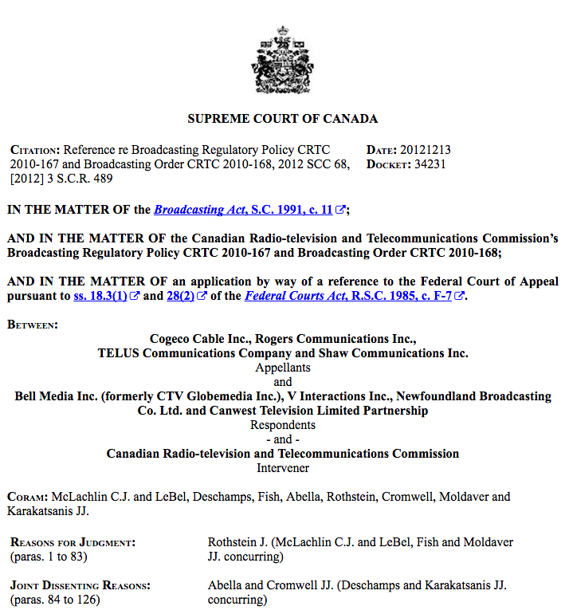
Case Study #4

Slide 143
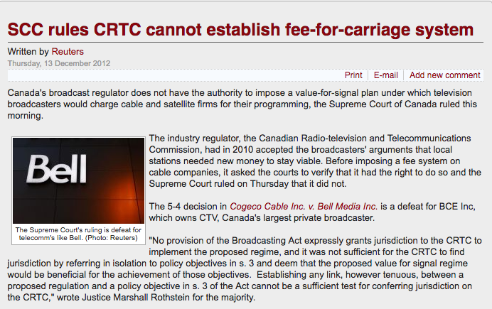
Impact of SCC fee for carriage decision

Slide 144
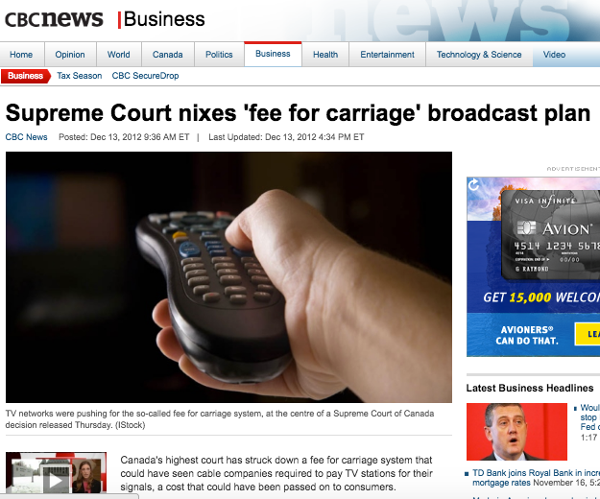

Slide 145
Majority
“…the CRTC seeks to implement what it terms a “value for signal regime”. This regime would permit broadcasters to negotiate with BDUs the terms upon which the BDUs may redistribute their signals…
In my respectful opinion, for two reasons, the provisions of the Broadcasting Act, considered in their entire context, may not be interpreted as authorizing the CRTC to implement the proposed value for signal regime. First, a contextual reading of the provisions of the Broadcasting Act themselves reveals that they were not meant to authorize the CRTC to create exclusive rights for broadcasters to control the exploitation of their signals or works by retransmission. Second, the proposed regime would conflict with specific provisions enacted by Parliament in the Copyright Act.”

Slide 146
“Policy statements, such as the declaration of Canadian broadcasting policy found in s. 3(1) of the Broadcasting Act, are not jurisdiction-conferring provisions. They describe the objectives of Parliament in enacting the legislation and, thus, they circumscribe the discretion granted to a subordinate legislative body... As such, declarations of policy cannot serve to extend the powers of the subordinate body to spheres not granted by Parliament in jurisdiction-conferring provisions.”

Slide 147
“The difference between general regulation making or licensing provisions and true jurisdiction-conferring provisions is evident when this case is compared with Bell Canada v. Bell Aliant Regional Communications, 2009 SCC 40, [2009] 2 S.C.R. 764. In Bell Aliant, this Court was asked to determine whether the creation and use of certain deferral accounts lay within the scope of the CRTC’s express power to determine whether rates set by telecommunication companies are just and reasonable. The CRTC’s jurisdiction over the setting of rates under s. 27 of the Telecommunications Act, S.C. 1993, c. 38, provides that rates must be just and reasonable. Under that section, the CRTC is specifically empowered to determine compliance with that requirement and is conferred the express authority to “adopt any method or technique that it considers appropriate” for that purpose (s. 27(5)).”

Slide 148
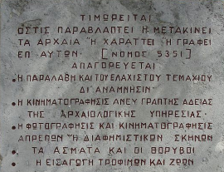
Conclusion: Suggested Rules?

Slide 149


Slide 150
“For Books are not absolutely dead things, but doe contain a potencie of life in them to be as active as that soule was whose progeny they are; nay they do preserve as in a violl the purest efficacie and extraction of that living intellect that bred them…
And though all the windes of doctrin were let loose to play upon the earth, so Truth be in the field, we do injuriously, by licencing and prohibiting to misdoubt her strength. Let her and Falshood grapple; who ever knew Truth put to the wors, in a free and open encounter
Lords and Commons of England, consider what Nation it is whereof ye are, and whereof ye are the governours: a Nation not slow and dull, but of a quick, ingenious, and piercing spirit, acute to invent, suttle and sinewy to discours, not beneath the reach of any point the highest that human capacity can soar to.”

Slide 151
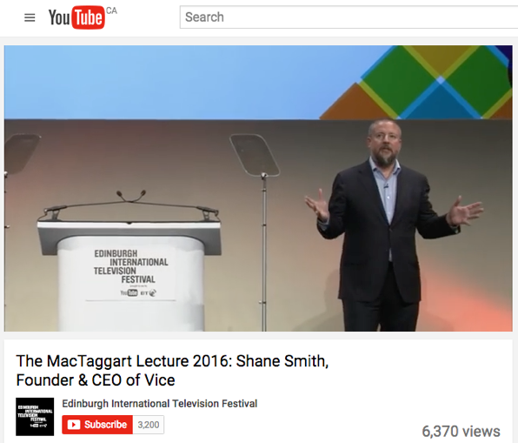
Second Thoughts?

Slide 152
DISCUSSION?

Slide 153
Questions?

Slide 154


A MATTER OF PERSPECTIVE

Slide 155
Collaborative Event: Pick a challenge that humanity is facing
Challenges facing humanity might include: environmental degradation, climate change, species extinction, racial inequality, gender inequality, income inequality, food security, freedom of speech (including artistic freedom), freedom of movement, and animal rights.
– Half of the class tries to identify as many ways in which information technology (digital media, communication and computing technology and networks) is making the situation worse.
– The other half of the class should try to identify ways in which it is making things better (or could make things better).

Slide 156
Coming Attractions
“Digital Utopias & Commercial Realities: The Strange Case of Net Neutrality”

Slide 157

Always include a cat picture

Slide 158
Our Academic Partners

