Slide 1

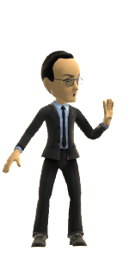
“Copyright Wars &
Intellectual Property Part B”
Foundations of Digital Media | Class 10
UBC
Fall 2017
Jon Festinger Q.C.
Centre for Digital Media
Allard Law of Law, UBC
QMUL School of Law (CCLS)
Festinger Law & Strategy
http://commlaw.allard.ubc
Twitter: @jonfestinger
jon_festinger@thecdm.ca

Slide 2
Logistics

Slide 3
Questions on..
Papers ?
Participation ?
Class Presentations ?

Slide 4
News of the Week

Slide 5
Yours?

Slide 6
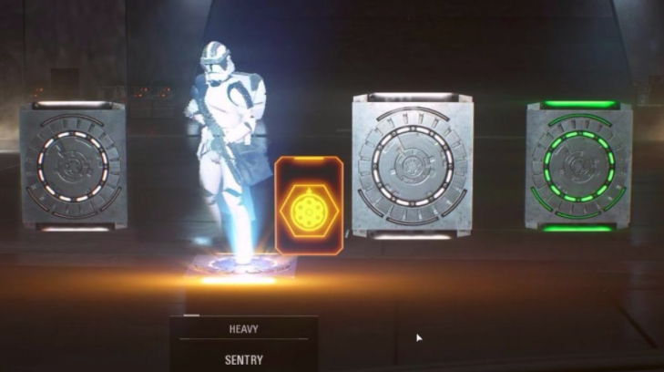
Loot Boxes

Slide 7
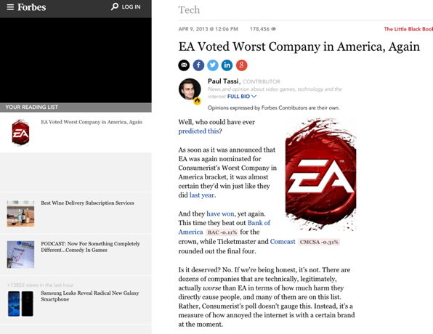
Understand the past to get the present

Slide 8
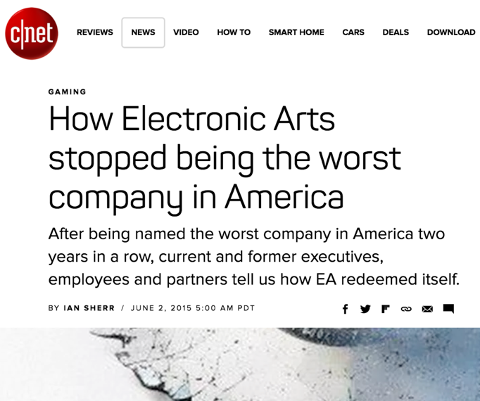

Slide 9
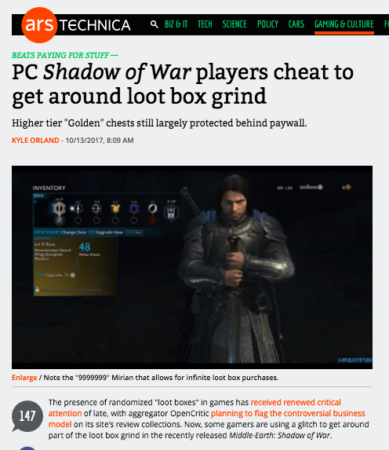

Slide 10
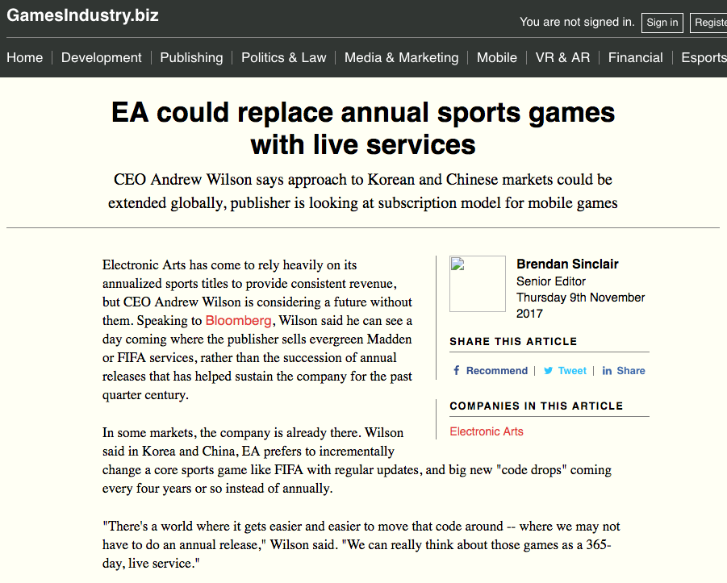

Slide 11
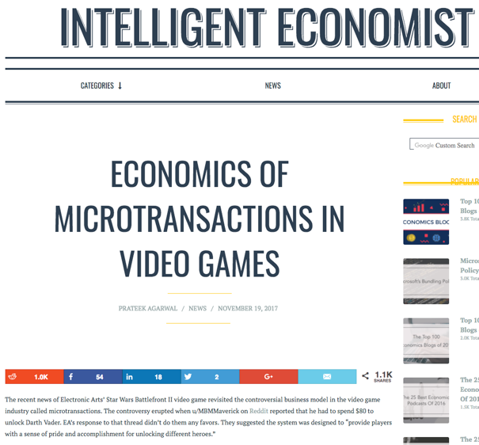

Slide 12
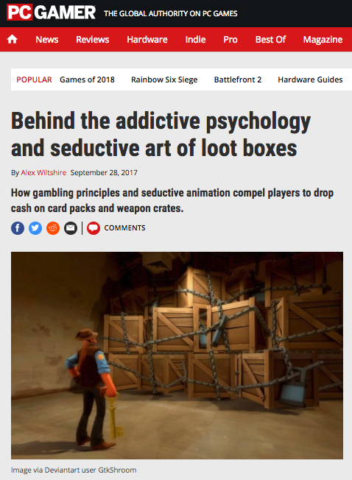

Slide 13
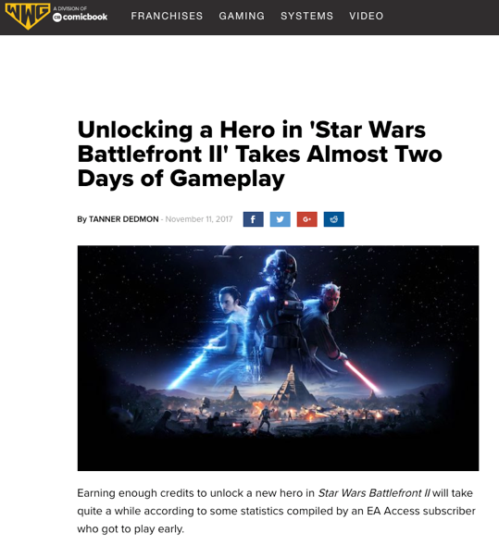

Slide 14
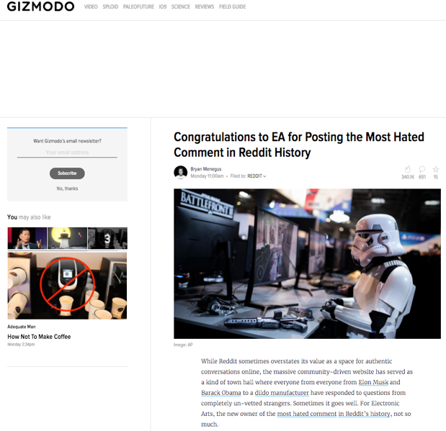

Slide 15
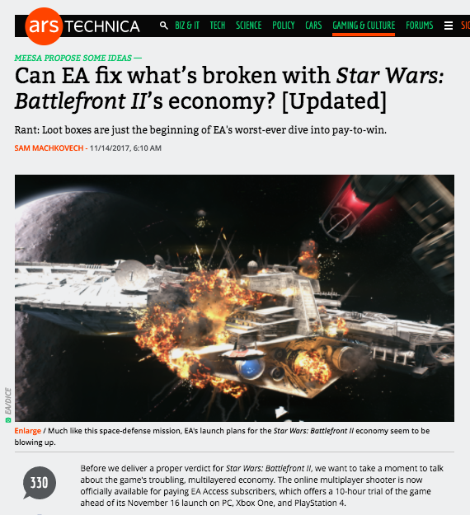

Slide 16
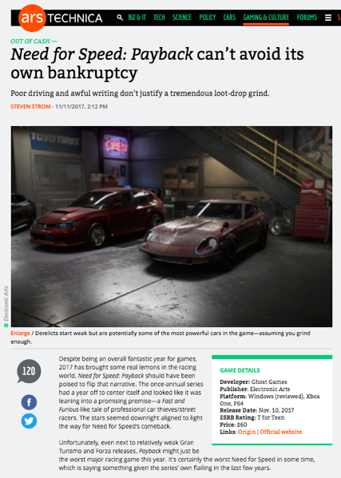

Slide 17
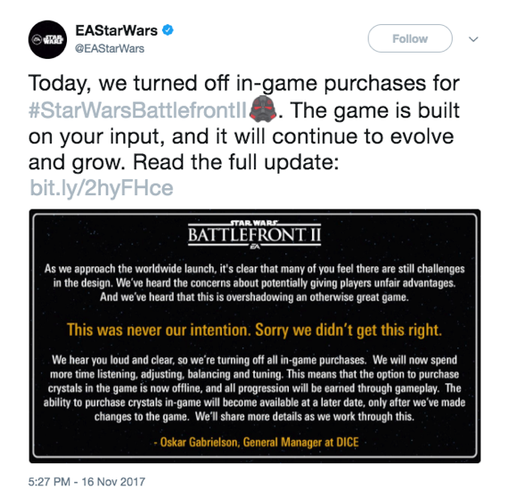

Slide 18
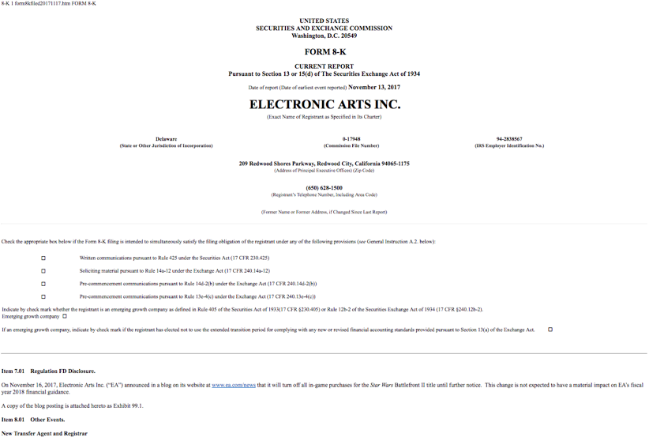

Slide 19
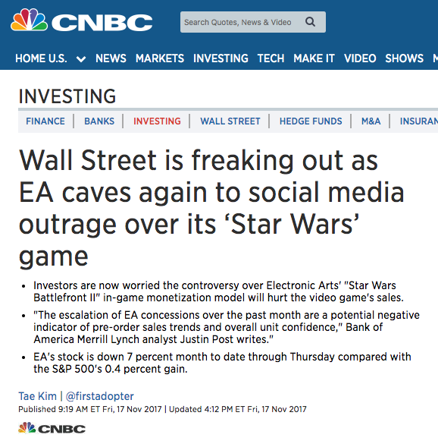

Slide 20
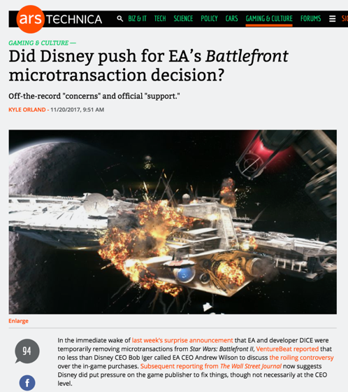

Slide 21
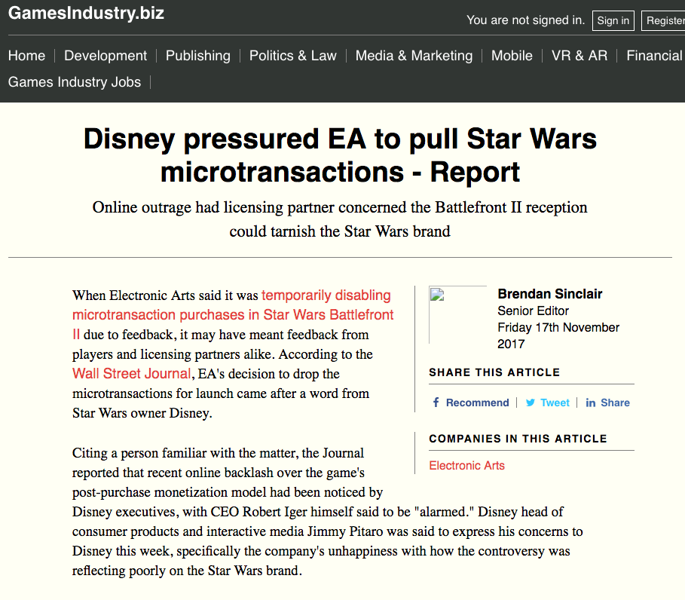

Slide 22
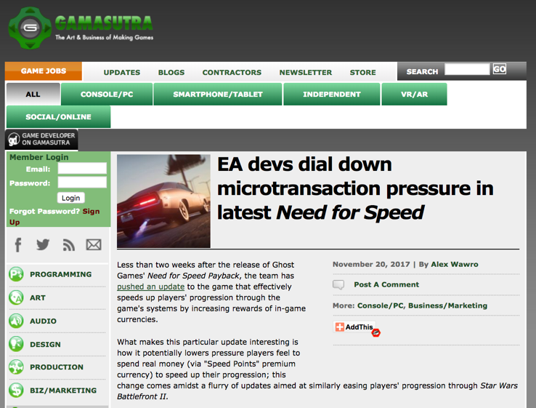

Slide 23
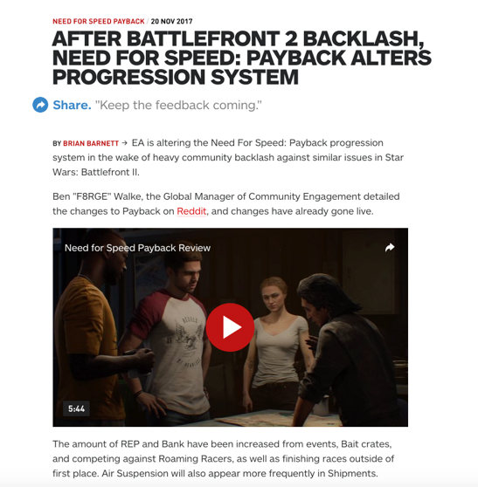

Slide 24
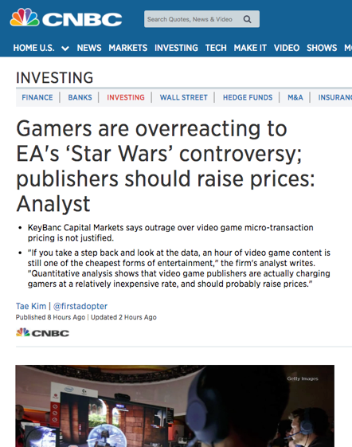

Slide 25
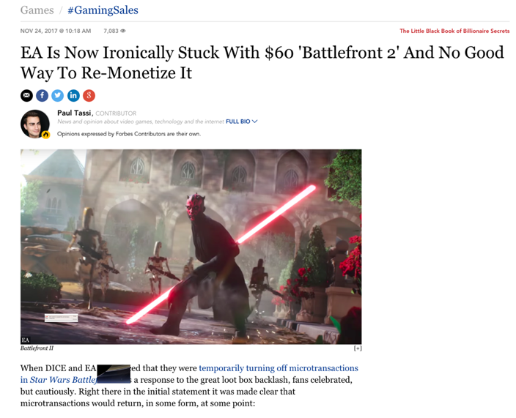

Slide 26
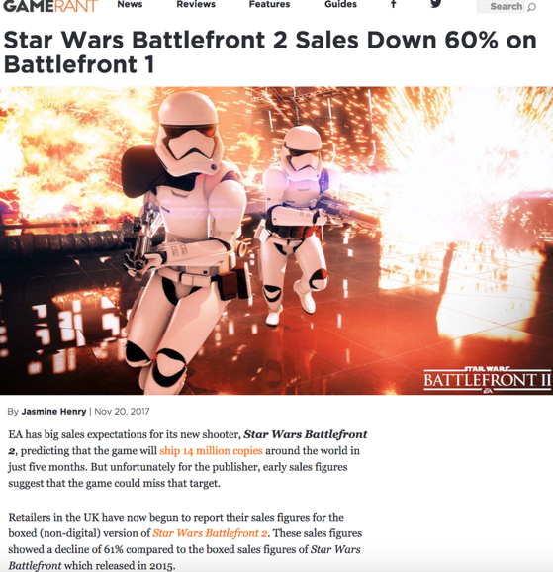

Slide 27
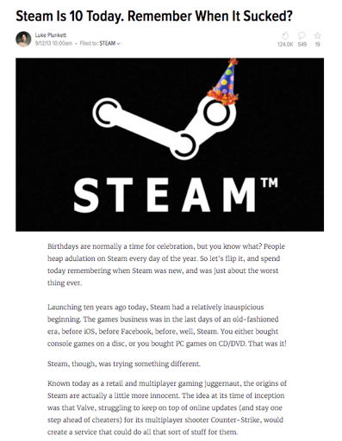
Remember…

Slide 28
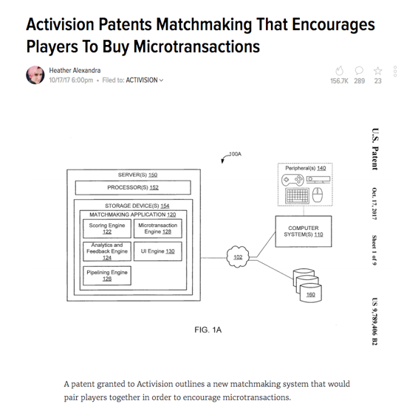

Slide 29
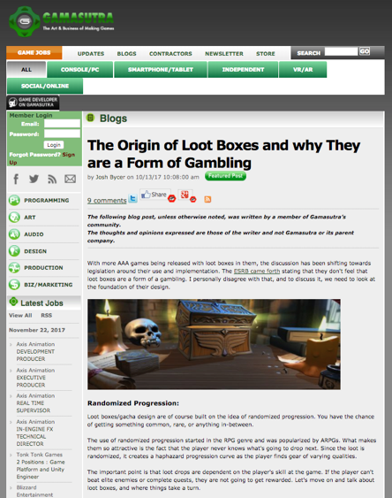

Slide 30
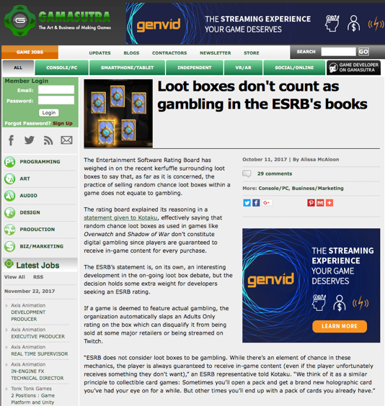

Slide 31
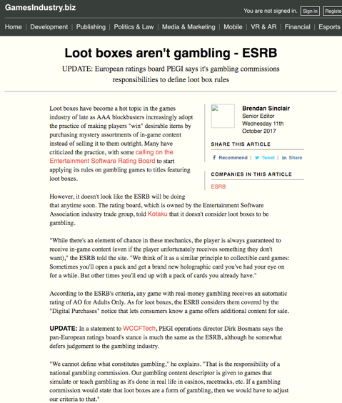

Slide 32
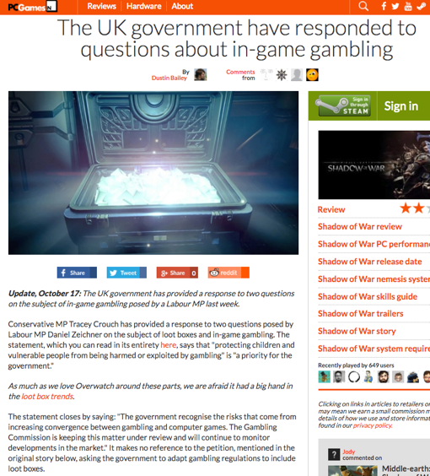

Slide 33
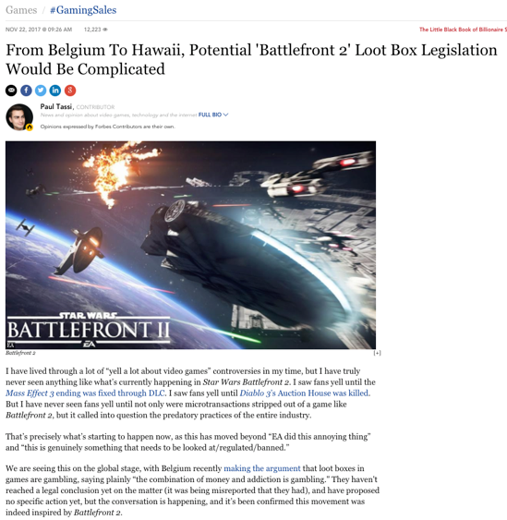

Slide 34
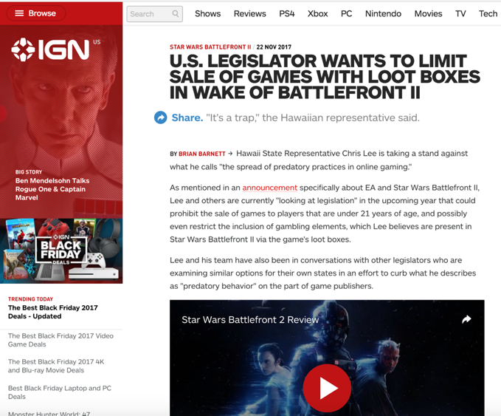

Slide 35
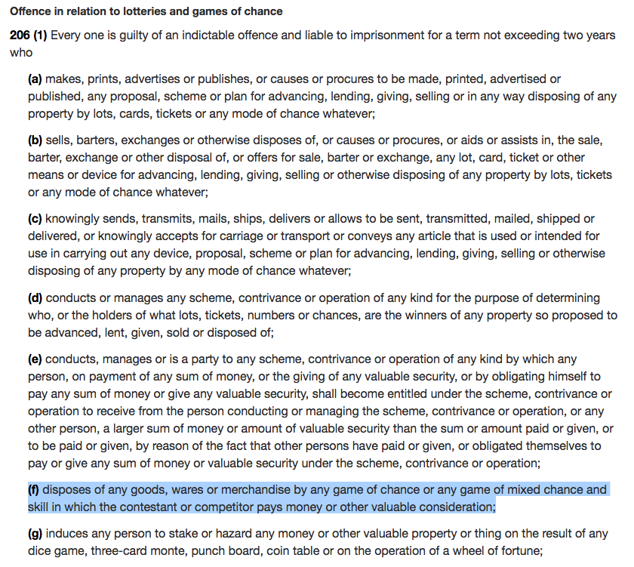

Slide 36
COMPETION ACT R.S.C., 1985, c. C-34
53(1): “No person shall, for the purpose of promoting, directly or indirectly, any business interest or the supply or use of a product, send or cause to be sent by electronic or regular mail or by any other means a document or notice in any form, if the document or notice gives the general impression that the recipient has won, will win, or will on doing a particular act win, a prize or other benefit, and if the recipient is asked or given the option to pay money, incur a cost or do anything that will incur a cost.

Slide 37
53(2) Subsection (1) does not apply if the recipient actually wins the prize or other benefit and the person who sends or causes the notice or document to be sent
(a) makes adequate and fair disclosure of the number and approximate value of the prizes or benefits, of the area or areas to which they have been allocated and of any fact within the person’s knowledge that materially affects the chances of winning;
(b) distributes the prizes or benefits without unreasonable delay; and
(c) selects participants or distributes the prizes or benefits randomly, or on the basis of the participants’ skill, in any area to which the prizes or benefits have been allocated.

Slide 38
So what’s in the EULA…
?

Slide 39
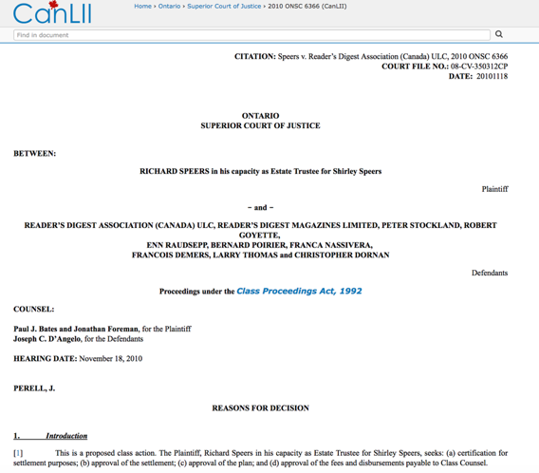
Class action…

Slide 40
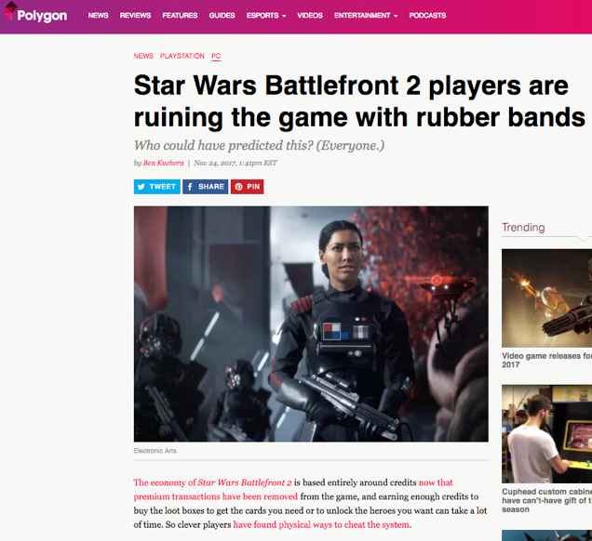

Slide 41
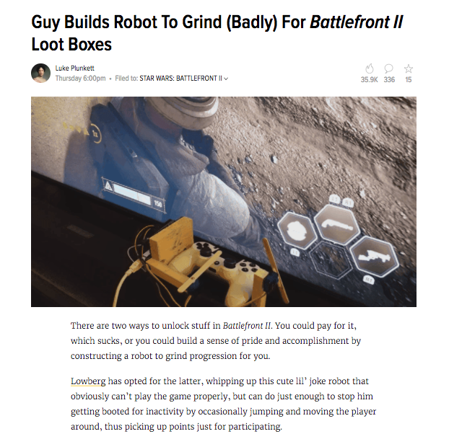

Slide 42
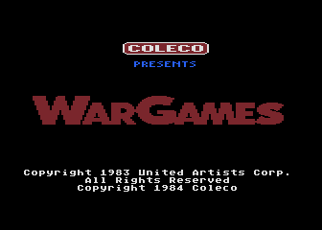
“Copyright Wars &
Intellectual Property”
Part 2 continued

Slide 43
WHERE DO IDEAS
COME FROM?

Slide 44
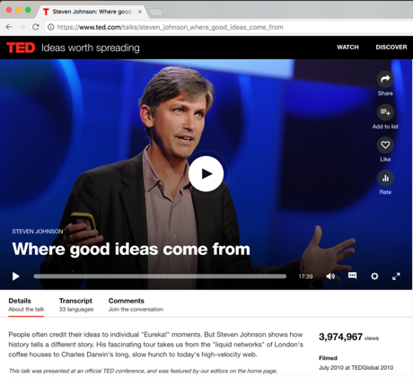
https://www.ted.com/talks/steven_johnson_where_good_ideas_come_from

Slide 45
THE ROMANTIC AUTHOR

Slide 46
“…copyright…means the sole right to...reproduce the work…in any material form whatever…”

Slide 47
BERNE CONVENTION (1886)

Slide 48
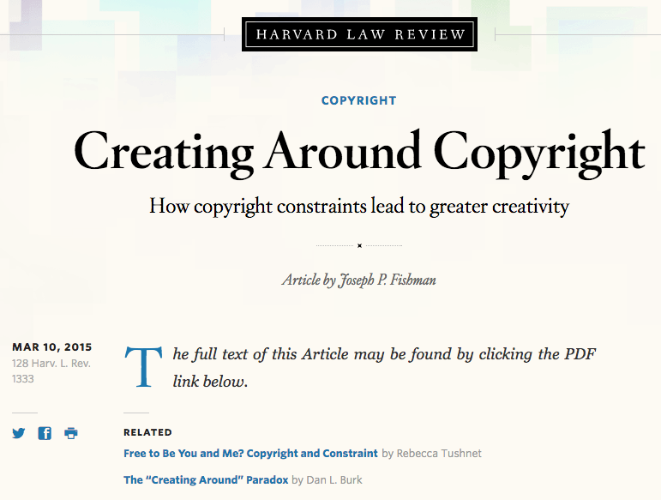

Slide 49
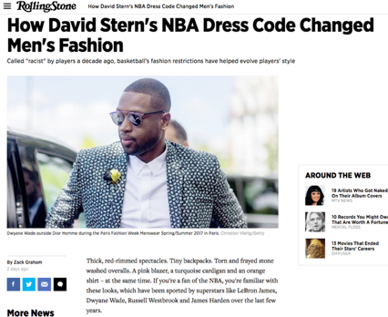
CONSTRAINTS ARE GOOD ??????

Slide 50
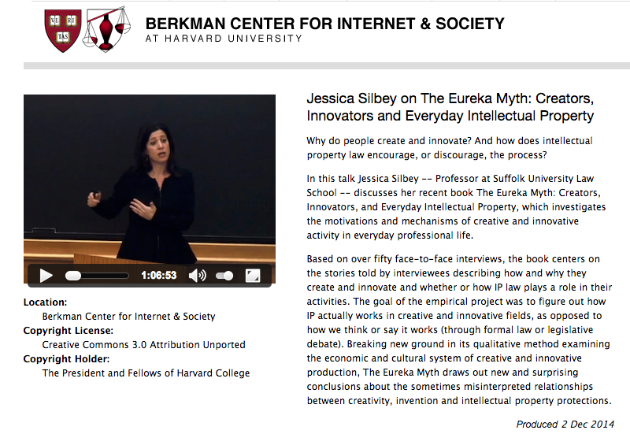
Creators do not need (nor want) additional constraints ?

Slide 51
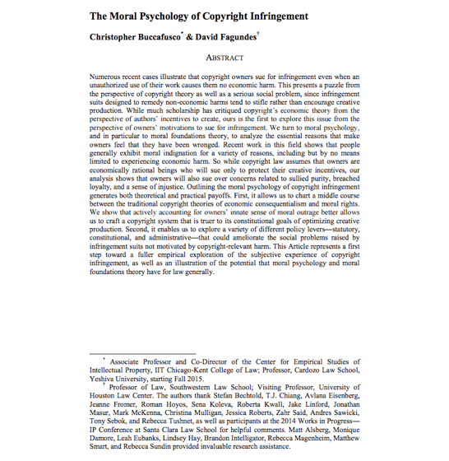
http://papers.ssrn.com/sol3/papers.cfm?abstract_id=2587339

Slide 52
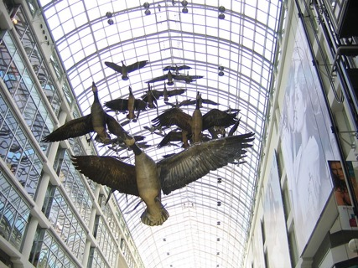
MORAL RIGHTS
Snow v. Eaton Centre

Slide 53
Not copyrightable?

Slide 54
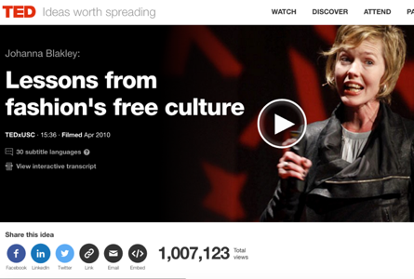
https://www.ted.com/talks/johanna_blakley_lessons_from_fashion_s_free_culture?language=en

Slide 55
GAMES?

Slide 56
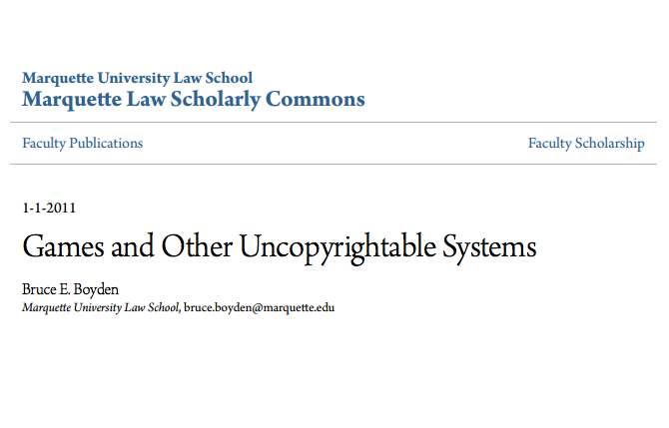
BOYDEN

Slide 57
FEMINIST THEORY

Slide 58
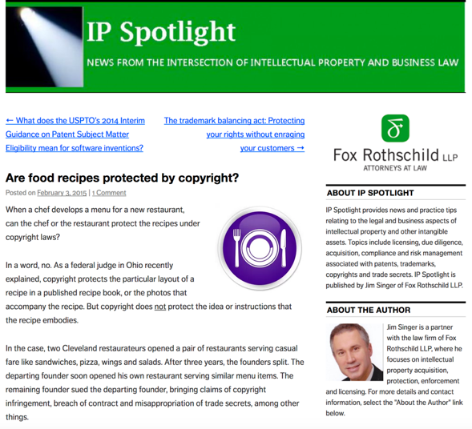

Slide 59
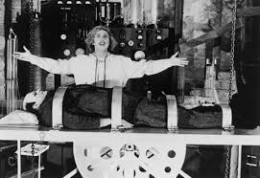
Must copyright be human?

Slide 60
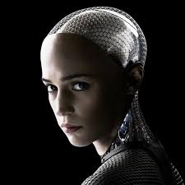
Ex Machina

Slide 61
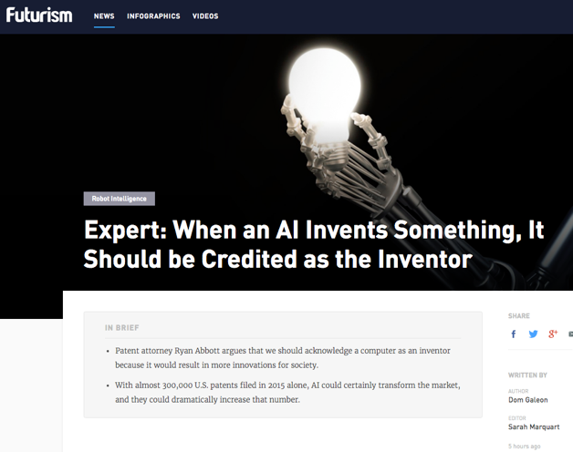

Slide 62
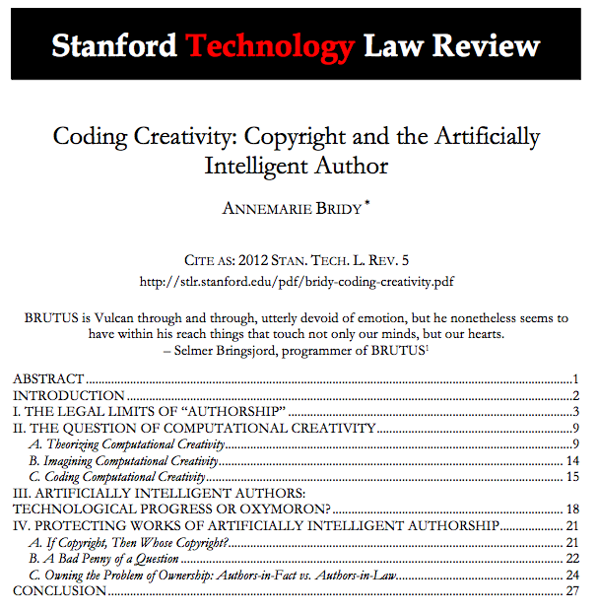
Work Made For Hire?

Slide 63
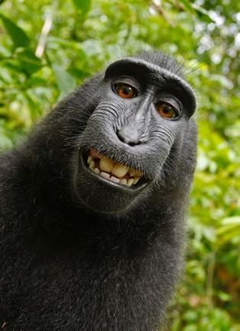

Slide 64
THE PUBLIC DOMAIN

Slide 65
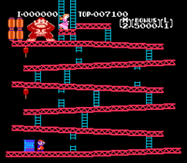

Is there even a copyright?
Universal v. Nintendo 1985 USCA

Slide 66


Slide 67
IDEAS?

Slide 68
EXPRESSION IS…

Slide 69
DICHOTOMY

Slide 70
IDEA/EPRESSION
DICHOTOMY

Slide 71
CREATIVE THRESHOLD

Slide 72
Atari v. Oman

Slide 73


Slide 74
BREAKOUT
PICASSO

Slide 75
ANOTHER DICHOTOMY:
LOW CREATIVE THRESHOLD/
HIGH DERIVATIVE RIGHTS

Slide 76
If Copyright, then what?

Slide 77
DERIVATIVE WORKS

Slide 78

MODS ?

Slide 79
FAN FICTION?
FAN ART?

Slide 80
CO-AUTHORSHIP POSSIBLE
(SORT OF)

Slide 81
NOT COLLABORATION FRIENDLY

Slide 82


Slide 83
HISTORY & PURPOSE
OF COPYRIGHT ?

Slide 84
3 THEORIES

Slide 85
ECONOMIC
PROPERTY
FREE SPEECH

Slide 86
STATUTE OF ANNE (1708)
AS FREE SPEECH

Slide 87

The Statute of Anne (1710) can be interpreted as the apotheosis in a trajectory of authorial freedom from censorship.

Slide 88


Slide 89
“For Books are not absolutely dead things, but doe contain a potencie of life in them to be as active as that soule was whose progeny they are; nay they do preserve as in a violl the purest efficacie and extraction of that living intellect that bred them…
And though all the windes of doctrin were let loose to play upon the earth, so Truth be in the field, we do injuriously, by licencing and prohibiting to misdoubt her strength. Let her and Falshood grapple; who ever knew Truth put to the wors, in a free and open encounter
Lords and Commons of England, consider what Nation it is whereof ye are, and whereof ye are the governours: a Nation not slow and dull, but of a quick, ingenious, and piercing spirit, acute to invent, suttle and sinewy to discours, not beneath the reach of any point the highest that human capacity can soar to.”

Slide 90
TRAJECTORY OF CREATIVE FREEDOMS
{KING..} Star Chamber (UK) abolished July 1641; {TO PARLIAMENT..} → Replacement of Royal censorship with Parliamentary censorship.
{TO REGULATOR..} “Licensing Order of 1643”: Parliament required authors to have a government license before a work could be published. Enforced by Stationers’ Company, a printers guild with the exclusive power to print literary works, and the responsibility to censor them, in return for monopoly on the printing trade.
{TO EXCLUSIVE GUILD..} “Licensing of the Press Act 1662” - "An Act for preventing the frequent Abuses in printing seditious treasonable and unlicensed Bookes and Pamphlets and for regulating of Printing and Printing Presses.”
{TO PUBLISHERS/AUTHORS..} “The Statute of Anne” 1710 moved control to publishers/authors…

Slide 91
The Statute of Anne (17010) can be interpreted as the apotheosis in a trajectory of authorial freedom from censorship.

Slide 92
Copyright law is territorial, not international.
Once published in a jurisdiction,
it gains that jurisdictions protections.
International treaties help facilitate enforcement.

Slide 93


FREE SPEECH/EXPRESSION

Slide 94
FAIR USE/FAIR DEALING

Slide 95

https://youtu.be/e6vwkuSH1cQ

Slide 96

THE 4 FACTOR TEST

Slide 97
Purpose and character of the use, including whether the use is of a commercial nature or is for non-profit, educational, news, review, parody or satire purposes;
The nature of the copyrighted work;
The amount and substantiality of the portion used in relation to the copyrighted work as a whole; and
The effect of the use upon the potential market for or value of the copyrighted work.

Slide 98
The 5th Factor:
TRANSFORMATIVE

Slide 99

WHAT IS
TRANSFORMATIVE
(ENOUGH) ?

Slide 100


Slide 101


Slide 102

TIME SHIFTING

Slide 103
EDUCATION/LIBRARIES

Slide 104
PARODY/SATIRE

Slide 105

https://youtu.be/2dvv-Yib1Xg

Slide 106
NEWS/REVIEW

Slide 107
DE MINIMIS

Slide 108
Query?:
1. Mashups
2. Reaction Videos
3. Memes

Slide 109



1.
2.
3.

Slide 110




Slide 111
ORIGINALITY?

Slide 112

Subconscious infringement
He’s So Fine v. My Sweet Lord

Slide 113

Collective Unconscious Non-Infringement
Preston v. 20th Century Fox

Slide 114
Scenes a Faire

Slide 115


Dead-rising wins declaratory judgment

Slide 116
NON COMMERCIAL USER
GENERATED CONTENT

Slide 117
Non-commercial User-generated Content, Copyright Act
29.21 (1) It is not an infringement of copyright for an individual to use an existing work or other subject-matter or copy of one, which has been published or otherwise made available to the public, in the creation of a new work or other subject-matter in which copyright subsists and for the individual — or, with the individual’s authorization, a member of their household — to use the new work or other subject-matter or to authorize an intermediary to disseminate it, if
(a) the use of, or the authorization to disseminate, the new work or other subject-matter is done solely for non-commercial purposes;
(b) the source — and, if given in the source, the name of the author, performer, maker or broadcaster — of the existing work or other subject-matter or copy of it are mentioned, if it is reasonable in the circumstances to do so;
(c) the individual had reasonable grounds to believe that the existing work or other subject-matter or copy of it, as the case may be, was not infringing copyright; and
(d) the use of, or the authorization to disseminate, the new work or other subject-matter does not have a substantial adverse effect, financial or otherwise, on the exploitation or potential exploitation of the existing work or other subject-matter — or copy of it — or on an existing or potential market for it, including that the new work or other subject-matter is not a substitute for the existing one.

Slide 118

NON COMMERCIAL MEANS?

Slide 119

USERS RIGHTS

Slide 120
RIGHT TO CREATE

Slide 121
NOT TRADEMARKS

Slide 122
NOT PATENTS

Slide 123
I.P. IS NOT ?

Slide 124
BUT CONTRACTS?

Slide 125
CONTRACTS CAN CHANGE
{almost} EVERYTHING

Slide 126


Slide 127

SLICE & DICE COPYRIGHT

Slide 128
Licensing v. Selling

Slide 129


Slide 130
WHY CAN’T YOU EASILY
FIND THE MOST RECENT
EULA/ToS ON-LINE?

Slide 131


Slide 132


Slide 133



Slide 134
Confidentiality Clauses

Slide 135
I.P. Disclosure Clauses

Slide 136
Restrictive Covenants

Slide 137


Slide 138
Designing an Internet Act:
SETTING POLICY PRIORITIES

Slide 139
Net neutrality
Privacy
Users’ rights/freedom to mod/meme/etc.
Freedom of expression/speech
Control of personal data
Algorithmic fairness
Transnational/International Rule-making Consistency
False news?
Piracy?

Slide 140



Shouldn’t Creativity Be More Important Than Property ?

Slide 141


Slide 142


All A MATTER OF PERSPECTIVE

Slide 143

Always include a cat picture

Slide 144
Our Academic Partners

