Slide 1

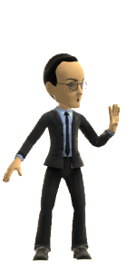
Introduction to the Course
Foundations of Digital Media | Class 1
UBC
Spring 2020
Jon Festinger Q.C.
Centre for Digital Media
Allard Law of Law, UBC
QMUL School of Law (CCLS)
http://commlaw.allard.ubc
Twitter: @jonfestinger
jon_festinger@thecdm.ca

Slide 2
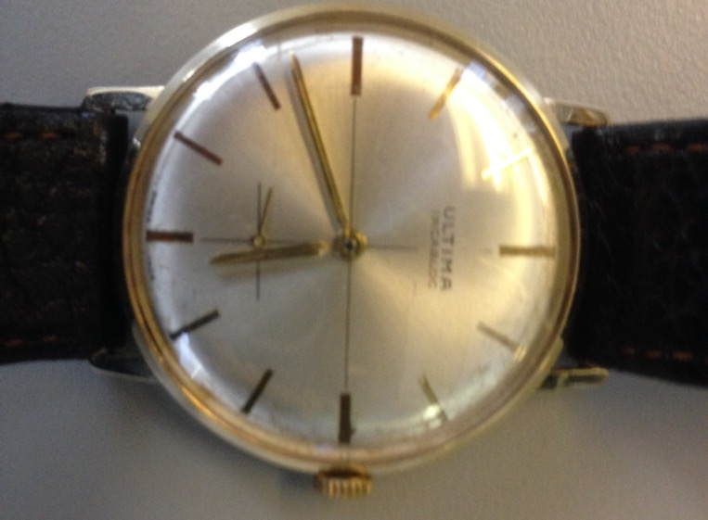
No, we will not spend the whole three hours…
Maybe an hour at most...

Slide 3
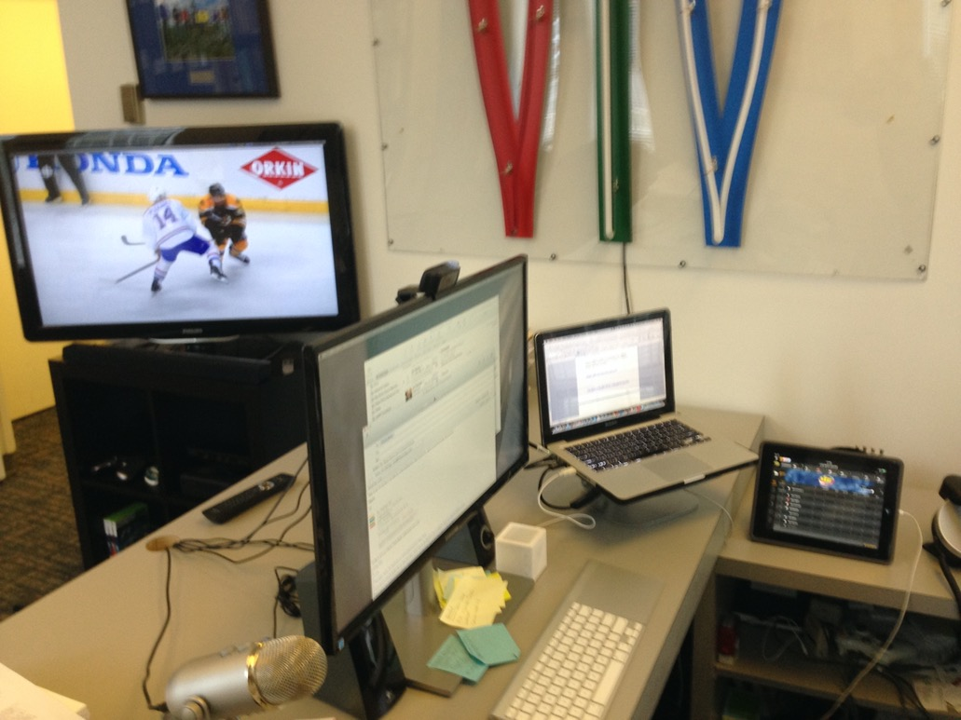
Computers Strongly Encouraged…

Slide 4
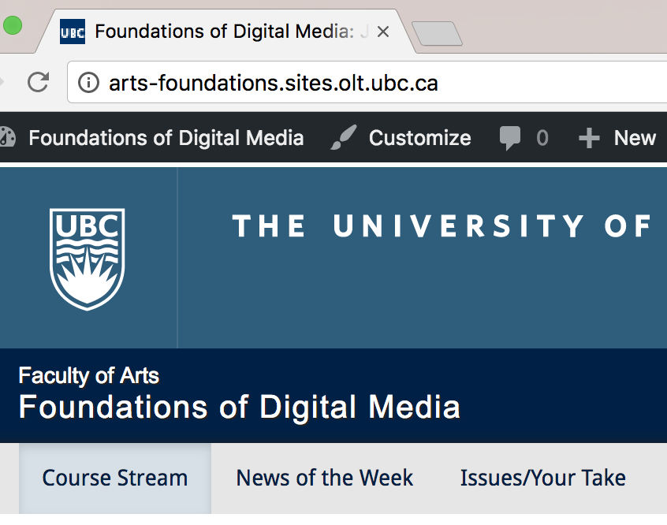
Course Website
http://arts-foundations.sites.olt.ubc.ca/

Slide 5
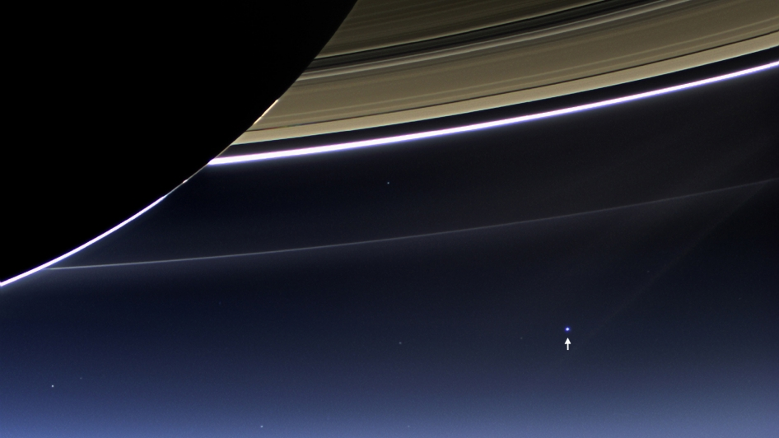
Perspective

Slide 6

Adjunct-ing at Allard School of Law since…

Slide 7

This is NOT a law course

Slide 8
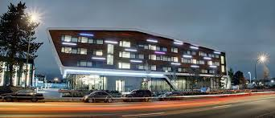
BRIEF Backstory…

Slide 9


Slide 10



Slide 11
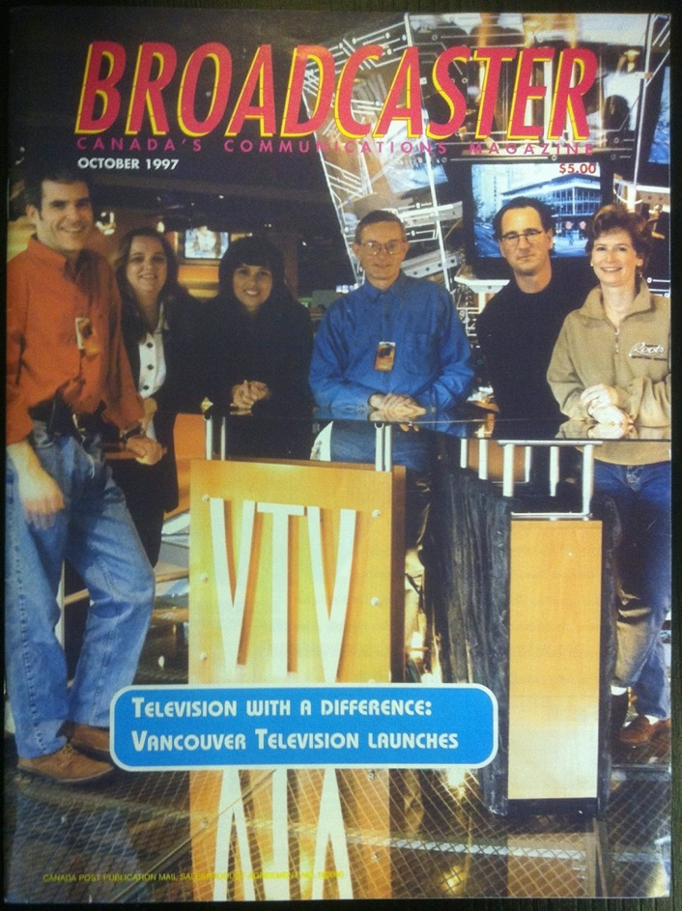

Slide 12


Slide 13


Slide 14

Back to the law…

Slide 15
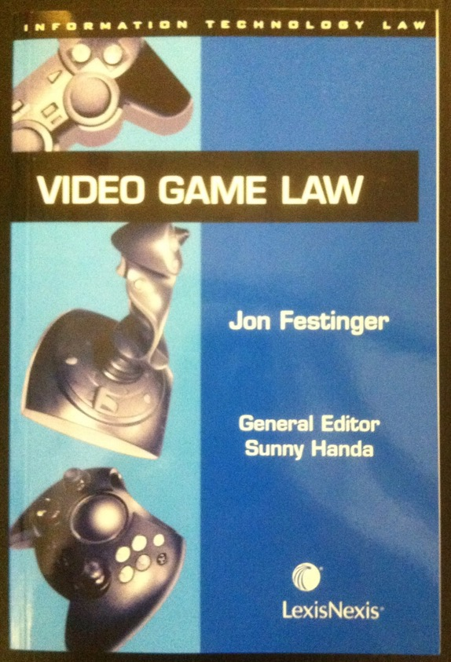

Slide 16
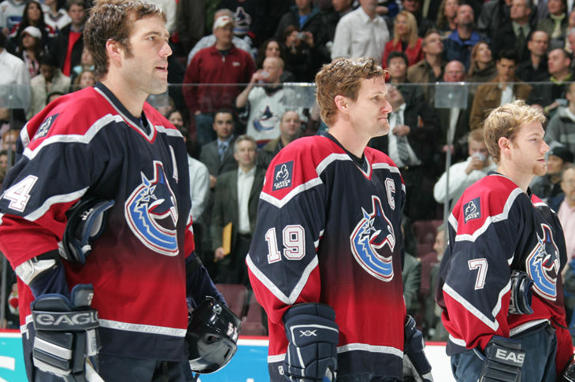
Every Canadian Kids Dream?

Slide 17
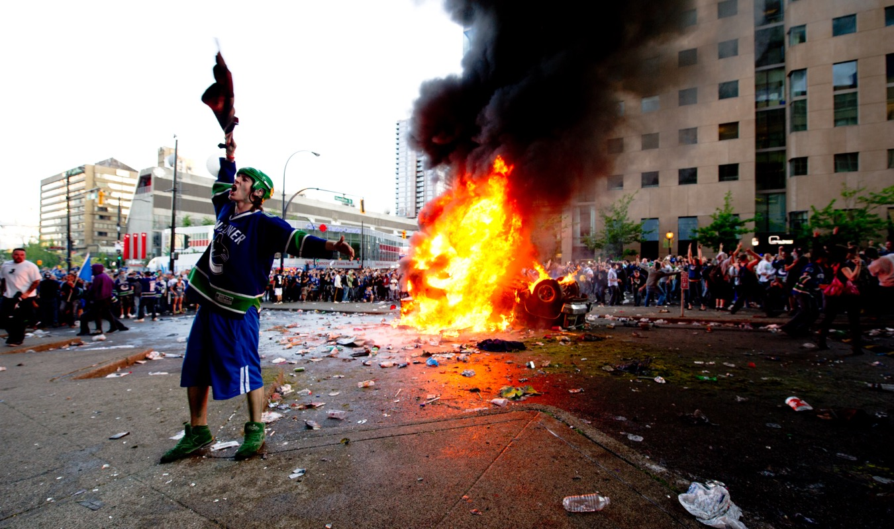
Left the Canucks in 2010…before

Slide 18
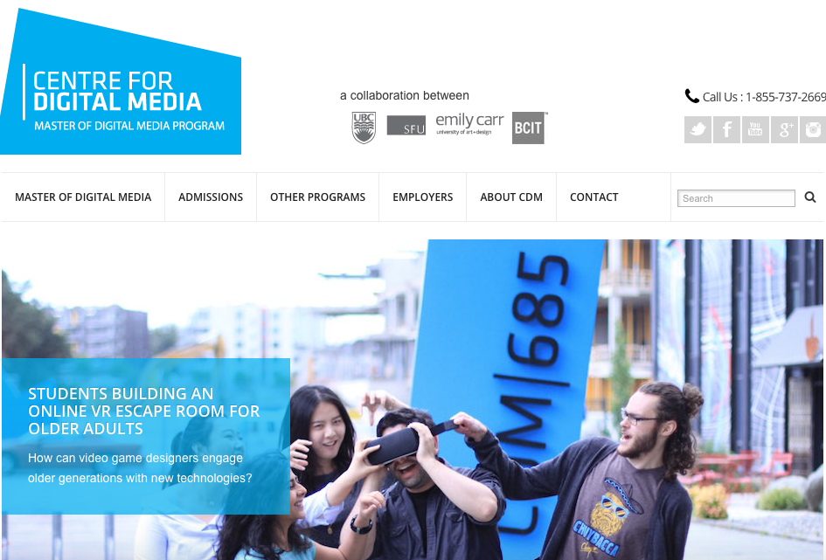
Teaching as addiction…

Slide 19
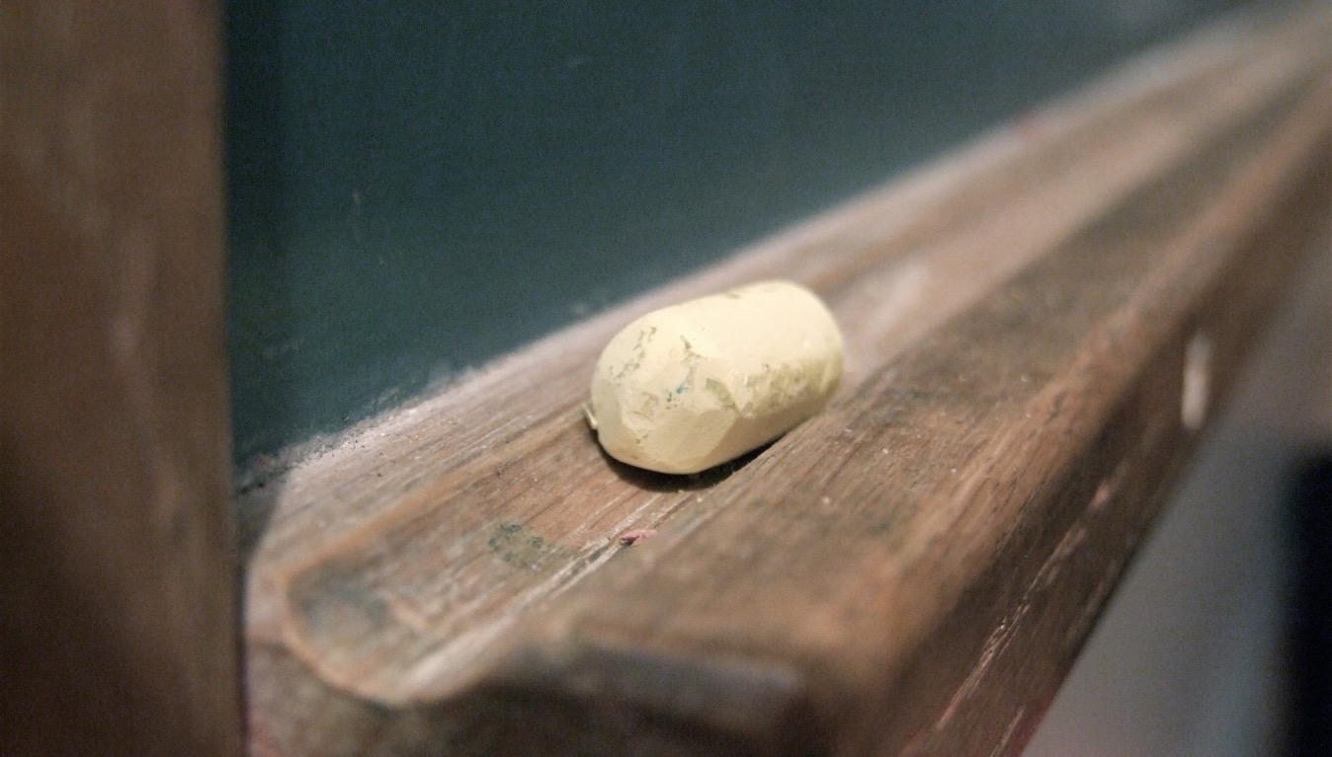
Pedagogy

Slide 20

Pedagogic Goals
One word:
ENGAGEMENT
Two words:
CREATING PERSPECTIVE
Three words:
APPRECIATING COMPLEXITY

Slide 21

Pedagogic Emphasis
Ground in (current) news
Find relevance
Identify ethics/norms
Encourage exploration

Slide 22
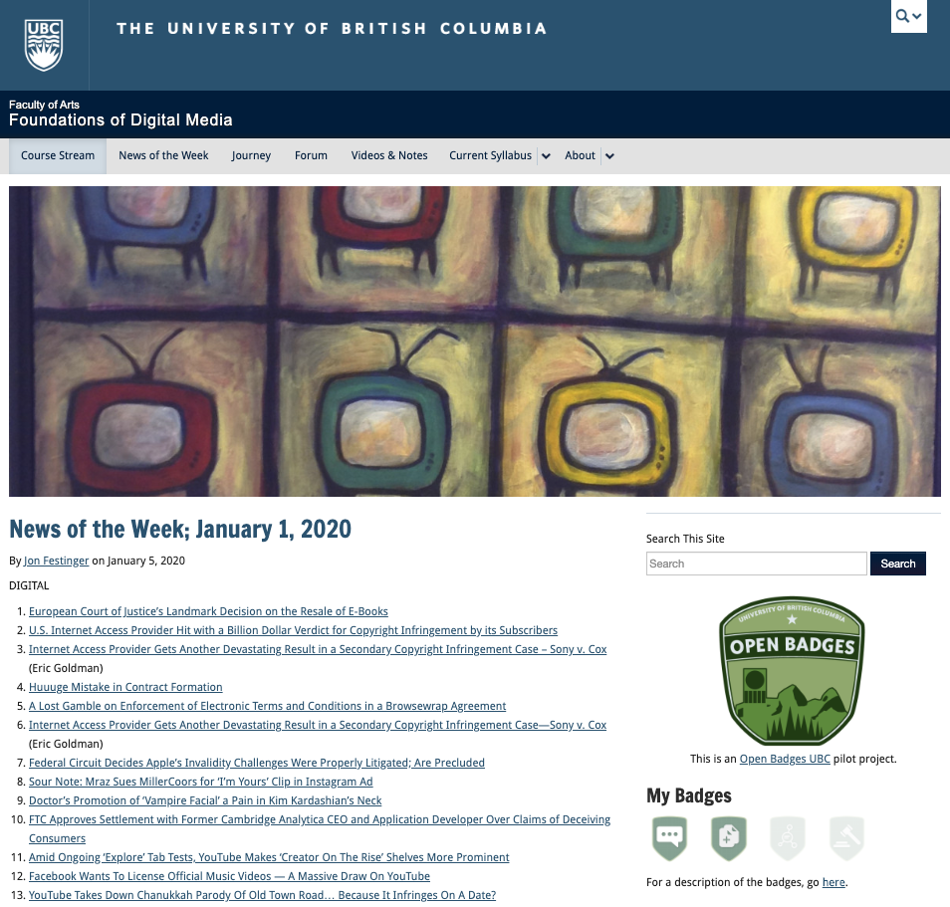

Slide 23
For full privileges on the website
1. Please create an account at http://cms.ubc.ca/ using your CWL.
2. Once you create an account and sign in at http://cms.ubc.ca/ you can click your name in the top right. Half way down the following page will be your WordPress email address.
3. Send me your WordPress email address at jfestinger@telus.net or at jon@fblawstrategy.com
4. Then, I will invite you to participate with authoring privileges via your WordPress email address.

Slide 24
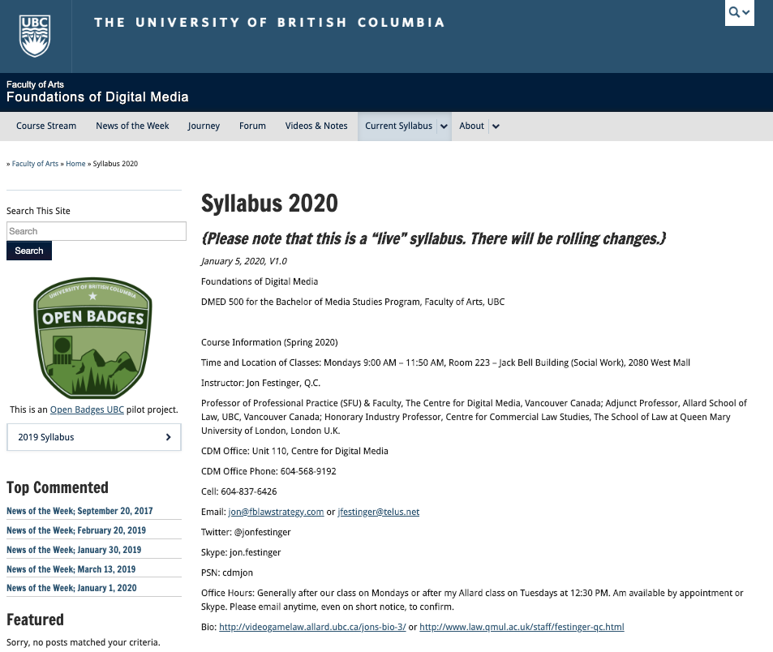

Slide 25
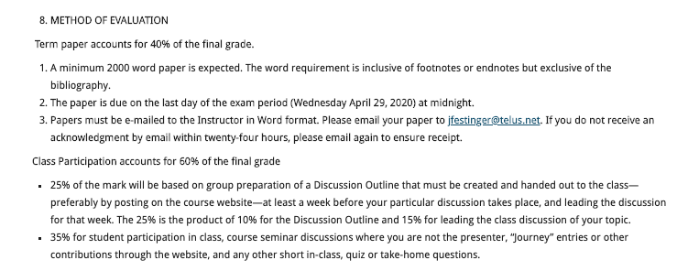

Slide 26


Slide 27
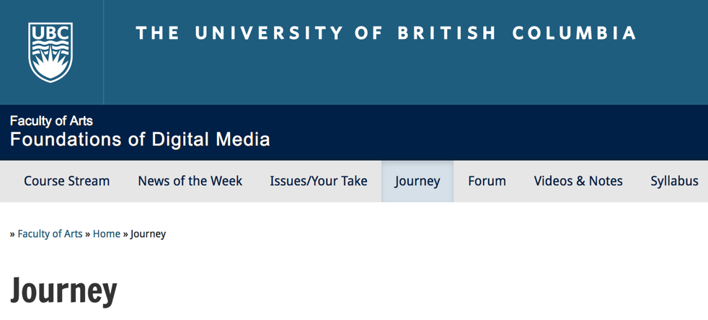
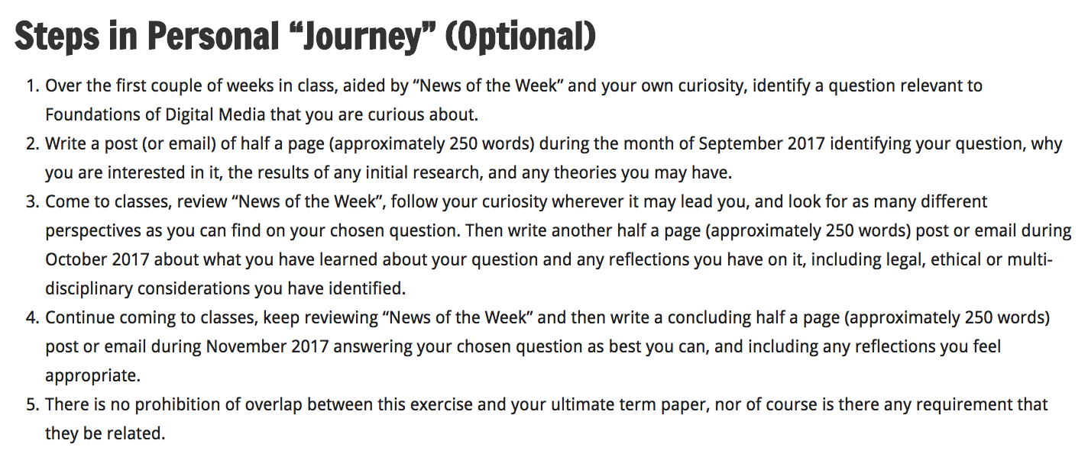

Slide 28
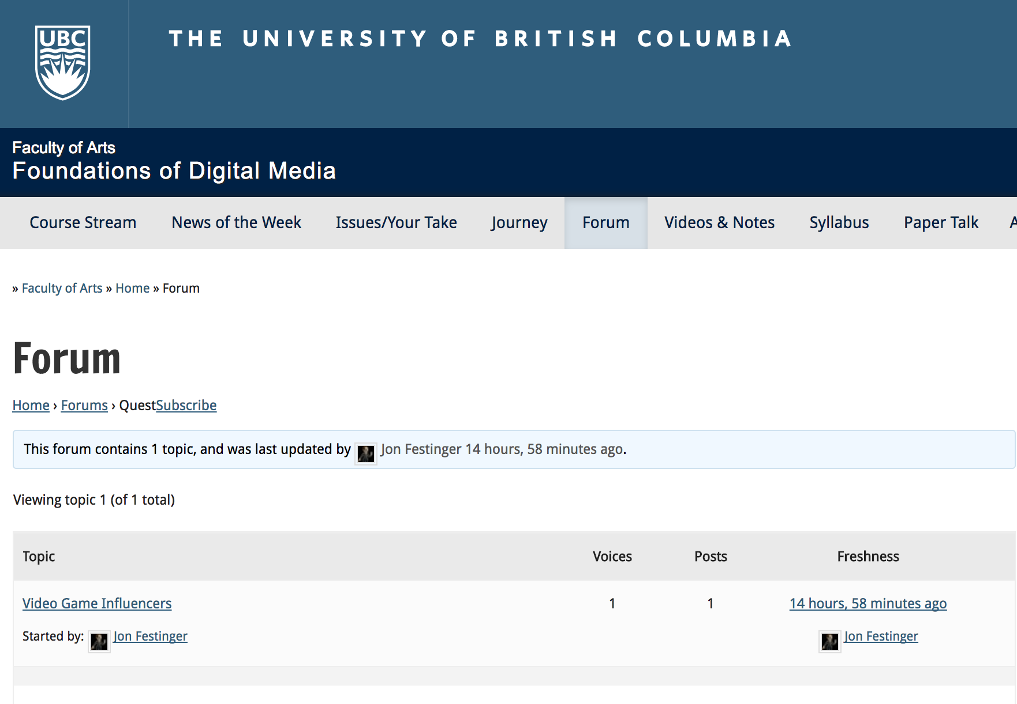

Slide 29


Slide 30

Anything & everything can be done via email if you prefer

Slide 31
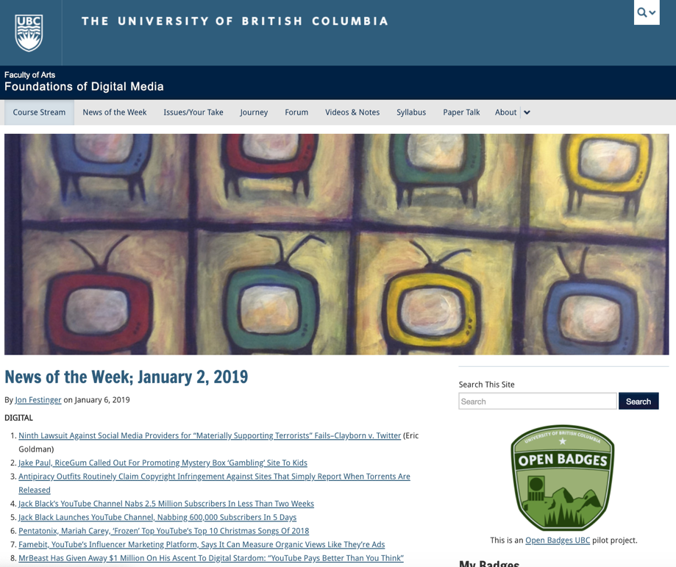
News of the “Week”…

Slide 32
TECHNOLOGIES

Slide 33
AI & Big Data
Blockchain
Internet of Things
Robots
VR & AR

Slide 34
CONTEXTS

Slide 35
Social & Interpersonal
Education & Health
Journalistic
Government / Democracy
Media, Entertainment & Video-Games

Slide 36
(Legal/Justice/Policy)
THEMES

Slide 37
Privacy/Surveillance
Copyright & IP
Regulation
Freedom of Expression
Constraints on Creativity

Slide 38
Questions?

Slide 39
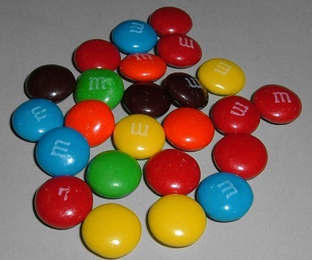
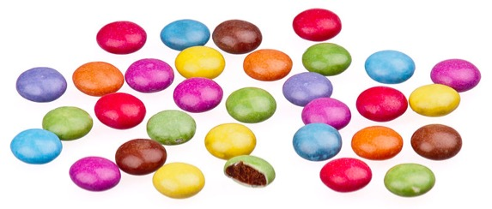
A MATTER OF PERSPECTIVE

Slide 40

Always include a cat picture

Slide 41
Our Academic Partners

